Slide 1











Introducing the Farm Practice Multi-Model Intercomparison and Ensemble Project (Farm-MIP)
April 14th-16th, 2026
Duke Farms, Hillsborough NJ
Presenter: Yushu Xia
Lamont Assistant Research Professor
Lamont-Doherty Earth Observatory, Columbia University
And many more…

Slide 2
Agroecosystem productivity and soil C, N, and water cycles are closely tied to multiple ecosystem service outcomes.
Process-based models have been widely applied to simulate agroecosystem dynamics, as they explicitly represent interactions between management practices and environmental drivers. However, substantial uncertainty remains.
There are numerous process-based models, which differ in input data requirements, model structure, parameterization methods, and the way they represent key biogeochemical processes tied to plant growth and soil carbon, nitrogen, and water cycles. As a result, model performance can vary widely across target outputs, ecosystems, and management conditions.
Multi-model intercomparison and ensemble offers a pathway for data sharing, standardized scenario analysis, model benchmarking, uncertainty diagnosis, improved process understanding, and more robust assessment of agroecosystem processes.
Background and motivation

Slide 3
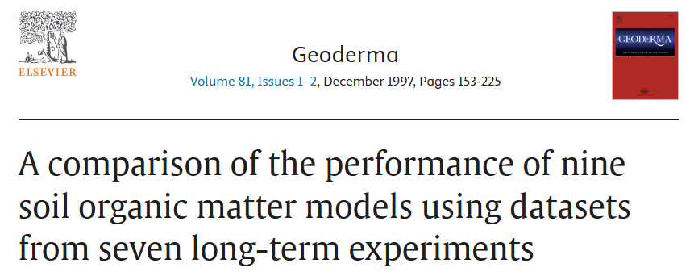
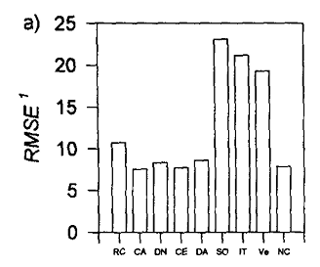
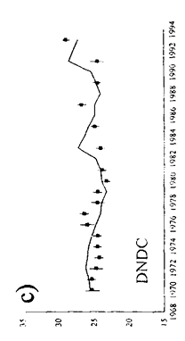
Example 1: Pioneering efforts in the 1990s
(Smith et al., 1997)
Participating models: RothC, CANDY, DNDC, CENTURY, DAISY, NCSOIL, SOMM, ITE, and Verberne.
Targeted variable for intercomparison: SOC from 0-30 cm.
Systems considered: Grassland, cropland, and woodland.
Conclusion: No one model performed better than all others across all datasets.
Model ensemble: Not conducted.

Slide 4
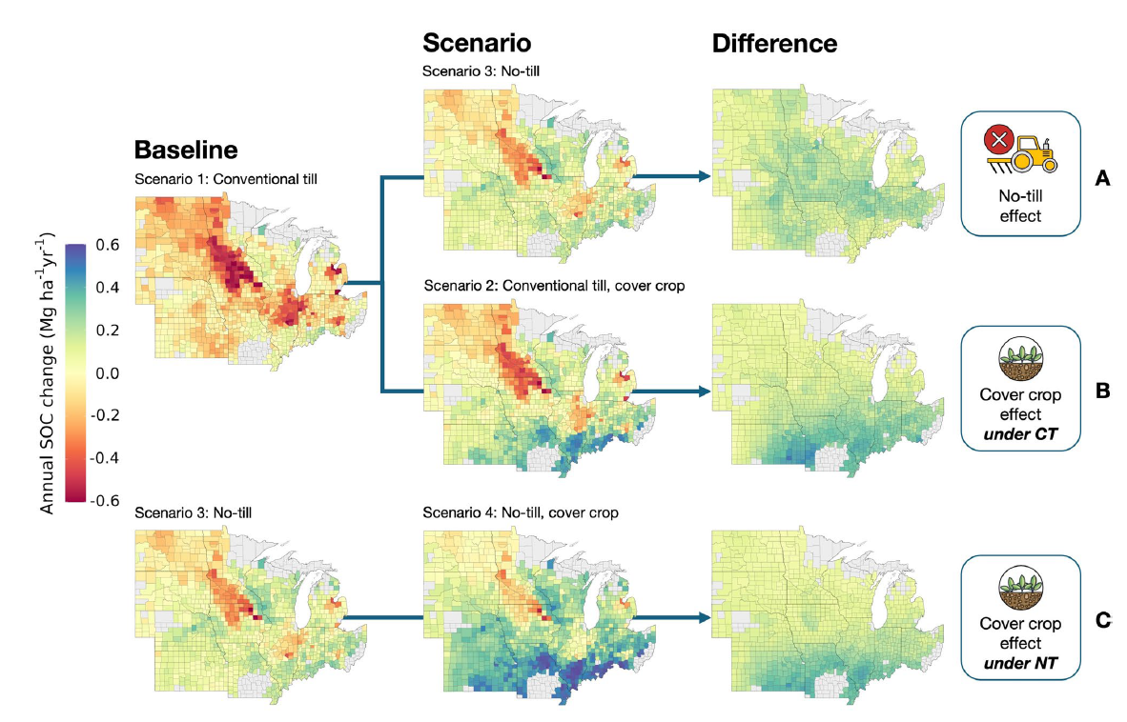
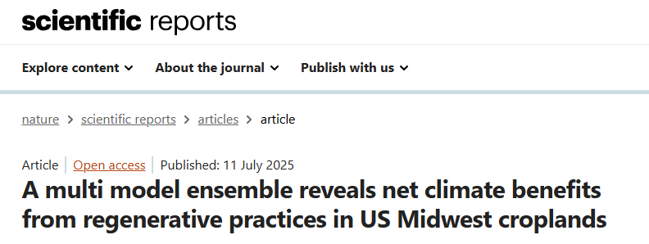
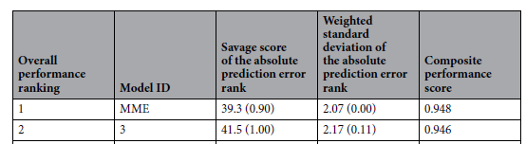
Example 2: Recent effort at the regional scale
(Basso et al., 2025)
Participating models: ARMOSA, CropSyst, DayCent, DSSAT, EPIC, SALUS, and STICS.
Targeted variable for intercomparison: SOC from 0-30 cm and soil N₂O fluxes.
Systems considered: Corn-soybean system.
Application: Comparison between regenerative and dynamic baseline at the regional scale (4 km grid size).
Model ensemble: Outlier removal + median.

Slide 5
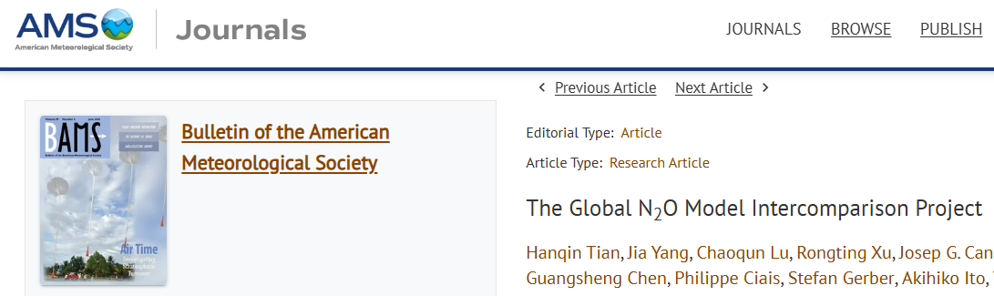
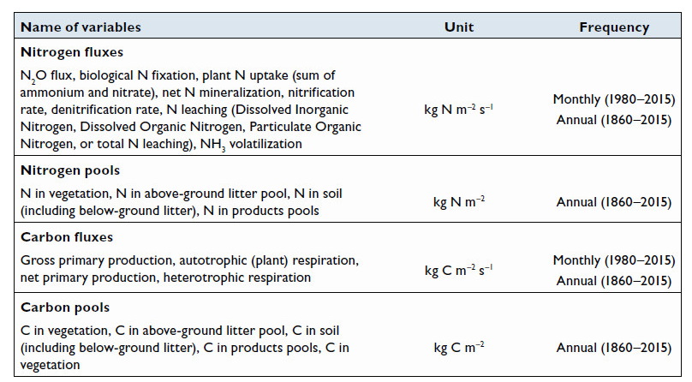
Example 3: Recent effort at the global scale
(Tian et al., 2018)
Participating models: CLM-CN, DLEM, LM3V-N, LPJ-GUESS, LPX-Bern, O-CN, ORCHIDEE, ORCHIDEE-CNP, TRIPLEX-GHG, VISIT
Targeted variable for intercomparison: terrestrial N₂O fluxes and other related C and N variables.
Systems considered: Agricultural and natural lands.
Model ensemble: Mean.

Slide 6
Major gaps in previous efforts I
For cropland-focused intercomparison efforts, coverage of regenerative management practices is sparse. Detailed management information is often inconsistently documented, which limits comparison between regenerative and conventional management practices using a dynamic baseline approach.
Validation datasets are frequently small in size and therefore cannot adequately capture spatiotemporal variability in SOC and N₂O fluxes.
Efforts have primarily focused on comparing SOC and N₂O without examining underlying processes that require comparison of additional variables (e.g., biomass, soil moisture, soil inorganic N contents, N leaching).
Relatively few efforts have provided intercomparison results of SOC for deeper soil depths.

Slide 7
Major gaps in previous efforts II
Some of the prior efforts have focused on intercomparison facilitated by a few modeling groups, rather than including model developers from each model to achieve more detailed model calibration and improvement.
Model ensemble efforts have mostly focused on reporting simple mean or median values.
Relatively few studies have conducted uncertainty analysis, which limits confidence in model predictions for policy and management applications.
There has been limited attention to SOC and N₂O modeling in grasslands due to limited data availability.

Slide 8
Timeline and key steps for Farm-MIP
This five-year project (2025-2029) leverages and expands AgMIP’s networks and modeling protocols for a coordinated national multi-model intercomparison and ensemble effort. This project aims to improve the modeling of soil carbon and nitrogen cycling pathways for U.S. croplands and grasslands, which will improve soil health management and reduce nutrient losses. This project will also address data and knowledge gaps to better inform management and policy decisions.
Establish a consortium of core modeling groups to coordinate model intercomparison and ensemble efforts.
1
Develop standardized protocols to guide data sharing, model simulations, and scenario analyses.
3
Compile, curate, and manage multi-scale datasets that support model inputs, calibration, and evaluation.
4
Innovate ensembling techniques by integrating AI and leveraging observational data.
5
Create a community-based platform to disseminate results and facilitate knowledge exchange.
6
Identify opportunities to improve soil carbon, nitrogen, water, and yield estimates through evaluation of existing efforts.
2

Slide 9








Core modeling groups and team members
Yushu Xia, Alexander C Ruane, Alisa Keyser, Bruno Basso, Cynthia Rosenzweig, Elizabeth Marshall, Erik Mencos, Evelyn Steglich, Gerrit Hoogenboom, Jaehak Jeong, Javier Osorio Leyton, Jeffrey Arnold, Jia Deng, Jonathan Smith, Jonas Jägermeyr, Kaiguang Zhao, Kieu Le, Laura Schreeg, Limei Ran, Luca Doro, Meijian Yang, Mike White, Natalie Kozlowski, Natalja Čerkasova, Sotirios Archontoulis, Stephen J Del Grosso, Stephen Ogle, Tommaso Tadiello, Terry Nipp, Xuesong Zhang, Ye Yuan, Yi Yang + Data Providers

Slide 10
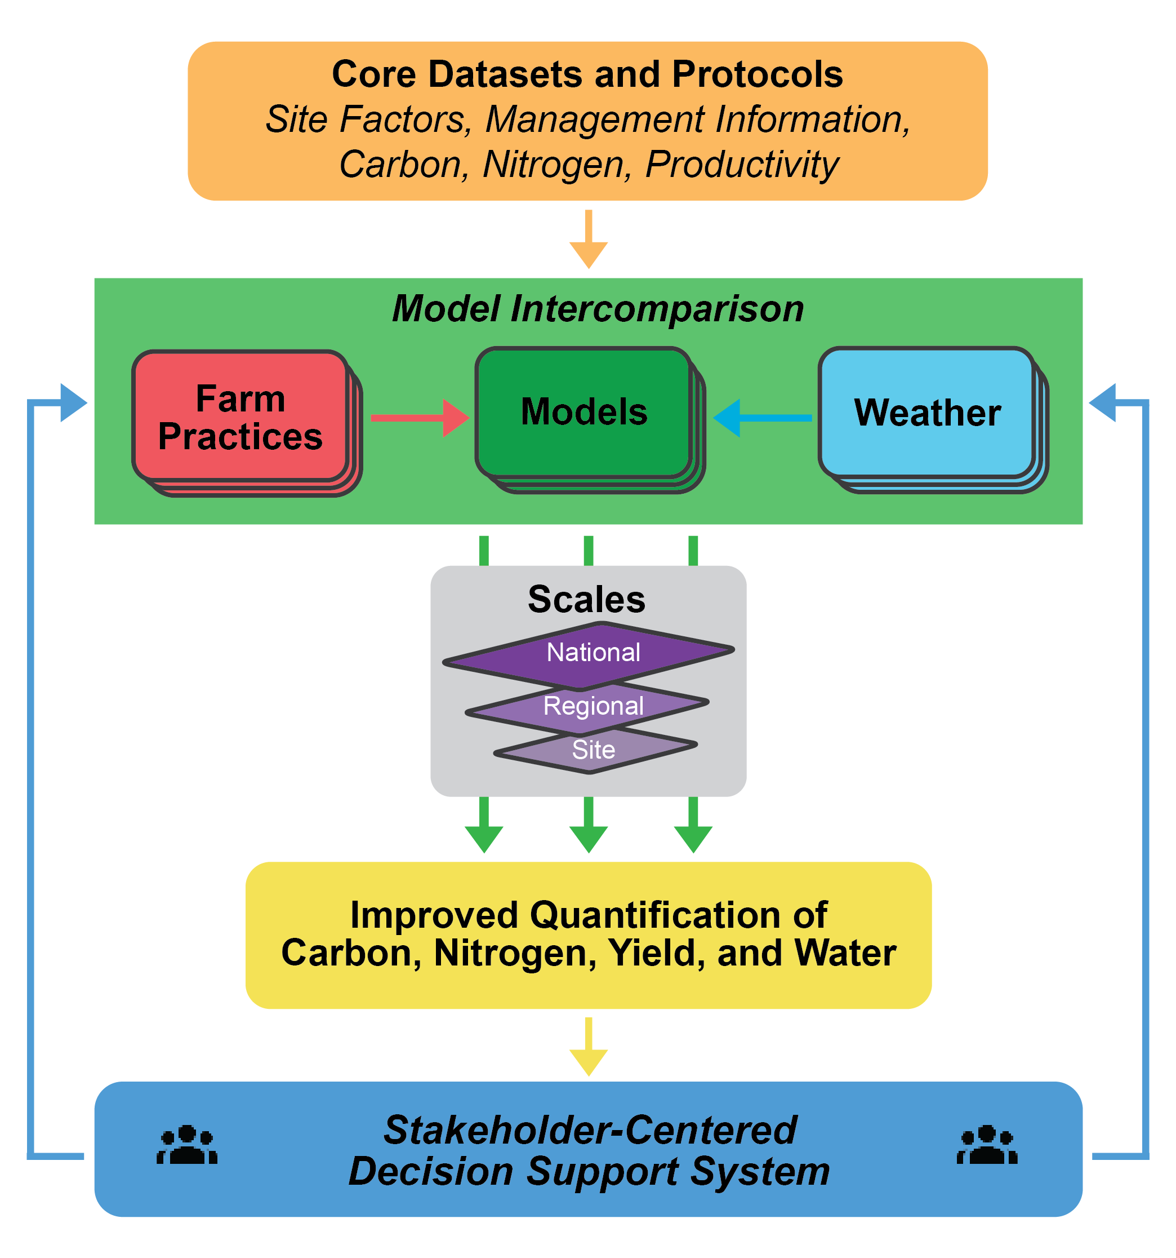
Scale and scientific questions
To what extent do existing process-based agroecosystem models consistently and accurately capture the influence of regenerative agricultural practices on soil health and N cycling?
When and where can regenerative agricultural practices sustain or increase agricultural productivity while improving water and N use efficiency?
How can AI, field data, and multi-model ensembles improve the reliability and scalability of simulated outcomes for ecosystem responses under changing environmental and management conditions?
What critical gaps should future data collection and modeling address to enhance monitoring and modeling of regenerative agricultural practices across spatial and temporal scales?

Slide 11
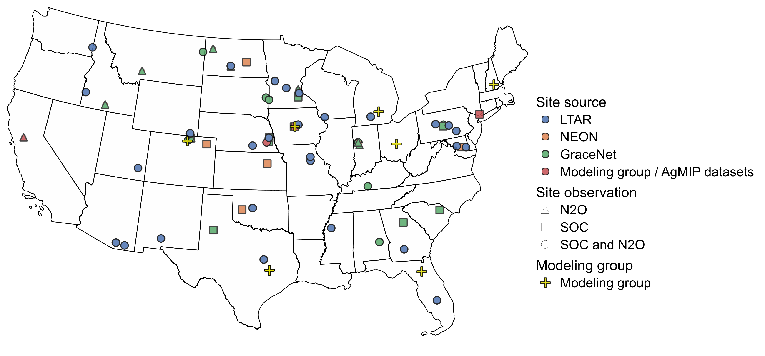
Field-scale: model calibration and evaluation sites
Networks: LTAR, LTER, NEON, Ameriflux, GRACEnet, global N₂O database.
Additional sources: Core modeling groups; meta-analytical studies; other known long-term experimental sites.
Site selection criteria:
Open-access data are prioritized;
Soil organic carbon (SOC) sites need to have repeated measures (3 years apart);
N₂O sites need to have ≥ bi-weekly measurements;
Detailed management, crop, soil, and weather data.
We offer co-authorship for data providers!

Slide 12
Minimum dataset
Minimum datasets for model simulation
1) Site: coordinates, land use history (20 years minimum)
2) Soil: initial conditions (if applicable), soil texture, pH, bulk density
3) Crop/ grass: yield/ biomass, type, rotation, cover crop details, planting/ establishment and termination/harvest dates
4) Weather: min and max temperature, precipitation, solar radiation (gridded dataset)
5) Management: tillage (type/ equipment, depth, and timing), fertilizer (type, amount, and timing), water (irrigation and drainage), grazing intensity, duration, and timing (for grassland)

Slide 13
Additional dataset
Optional datasets
Soil of these datasets can be extracted from public survey or gridded datasets
1) Soil: daily soil moisture and temperature; depth-based soil hydraulic properties; CEC; drainage class; soil albedo; anion adsorption coefficient
2) Plant: anthesis and maturity dates; harvest index; aboveground and belowground biomass or biomass tied to different plant components; LAI; GPP; NPP; crop height; NEE; ecosystem respiration; soil respiration; vegetation index
3) Weather: VPD; relative humidity; dew point temperature; wind speed and direction; air pressure
4) Management: cultivars; planting density; mulching; grass cutting or mowing; pesticide application

Slide 14
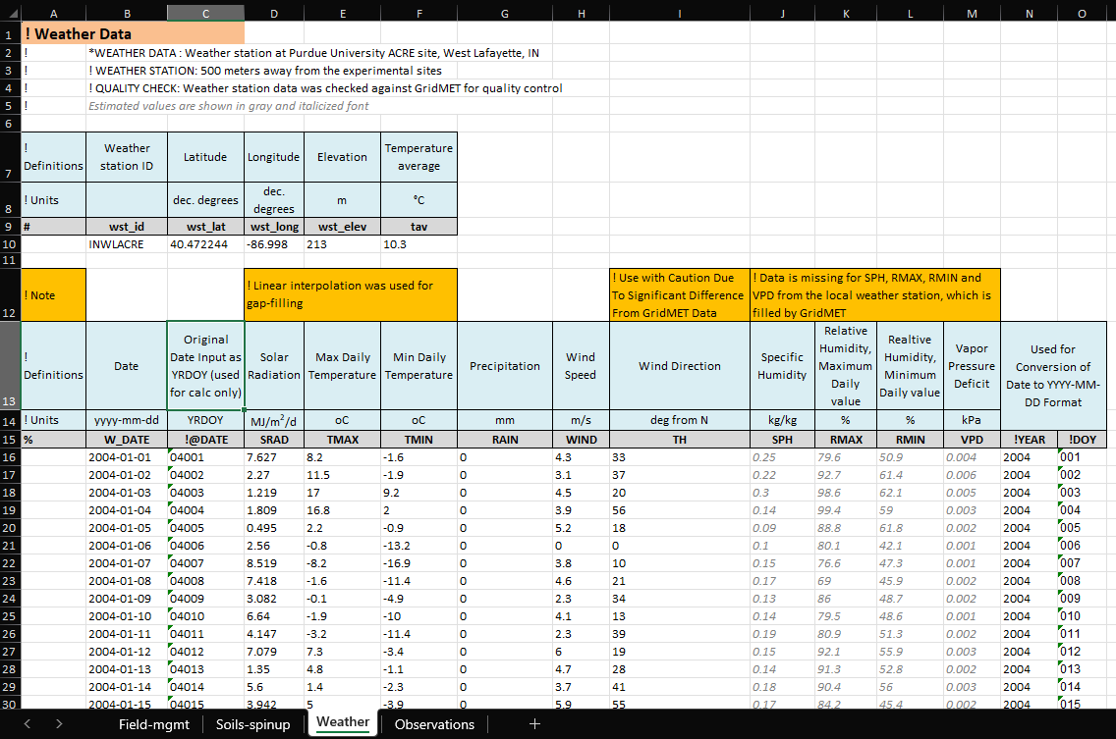
Standardized model input and observations

Slide 15
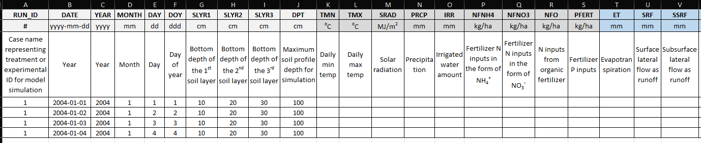
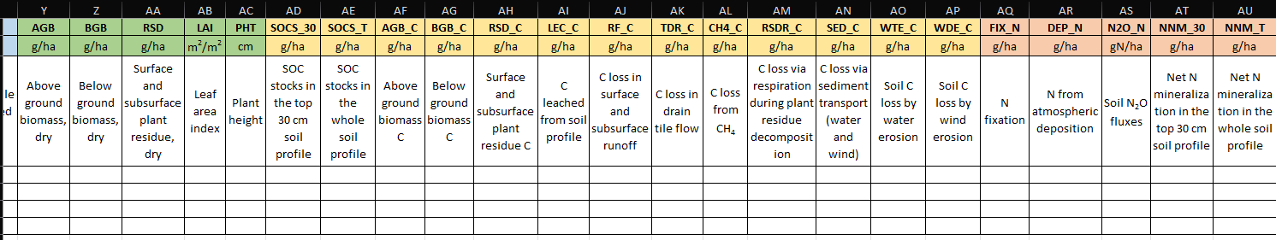
Standardized model output template
We compare outputs related to plant growth as well as soil C, N, and water cycles.

Slide 16
Standardized scenario analysis
Main category | Detailed category | Levels for evaluation
Nutrient management | N input rate | Multiple N application rates to assess nonlinear responses in crop productivity and soil C-N dynamics
 | Fertilizer source | Comparison of organic and synthetic fertilizer inputs
 | Synthetic fertilizer type | Evaluation of different synthetic fertilizer forms (e.g., urea-based, nitrate-based)
 | Fertilizer timing and incorporation method | Variation in timing (e.g., pre-plant, split, in-season) and method (e.g., broadcast, banded) of fertilizer applications
Tillage | Tillage and residue management | Conventional, reduced, and no-till systems with contrasting residue retention or removal
Water | Irrigation system | Irrigated vs. rainfed production systems
 | Drainage system | Tile-drained vs. undrained soil conditions
Cropping system | Crop type, cover cropping, and rotation | Continuous corn, corn-soybean rotation, and rotations including wheat and/or cover crops
Grazing | Grazing intensity (pasture) | Multiple levels of grazing pressure for pastureland
Weather | Interannual moisture conditions | Wet vs. dry years to evaluate system responses to moisture variability

Slide 17
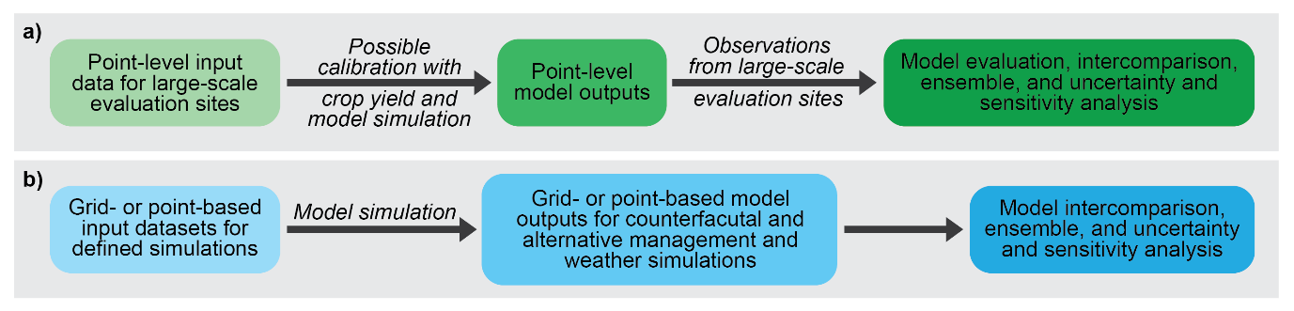
Broader scale activities
Point-based evaluation data
1) Observations not used for site-level calibration/ evaluation
2) Network or survey-based datasets
USDA NASS, RaCA, DSP4SH, NAPESHM, etc.
3) Meta-analysis datasets
4) Other large-scale datasets
Aboveground biomass, soil moisture, C fluxes, etc.

Slide 18
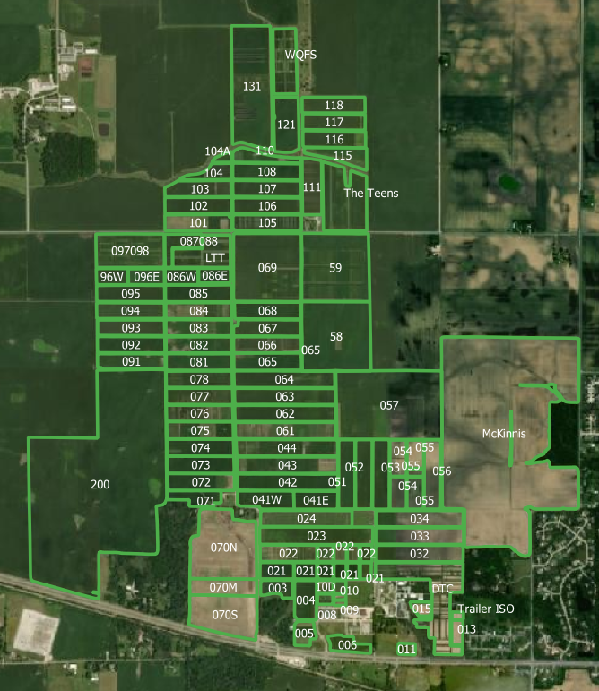
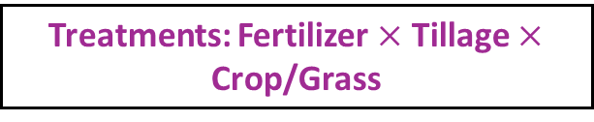
Case study: Phase 0 testing
Treatments: Fertilizer $×$ Tillage $×$ Crop/Grass
Purdue University Agronomy Center for Research & Education (ACRE): A GRACEnet site
Trt # | Treatment Descriptor | Rotation | N Treatment | Project Scenario | Cover Crop | Residue Removal | Surface Residue Cover
1 | Conventional tillage (fall chisel & spring disk) | Corn-Soybean | All N fertilizer (220 lbs/A) applied to corn plots as liquid UAN before planting | 1=Business as usual | None | No | 31%
2 | No-till, all fertilizer applied before planting |  |  | 2=Max C sequestration |  |  | 93%

Slide 19
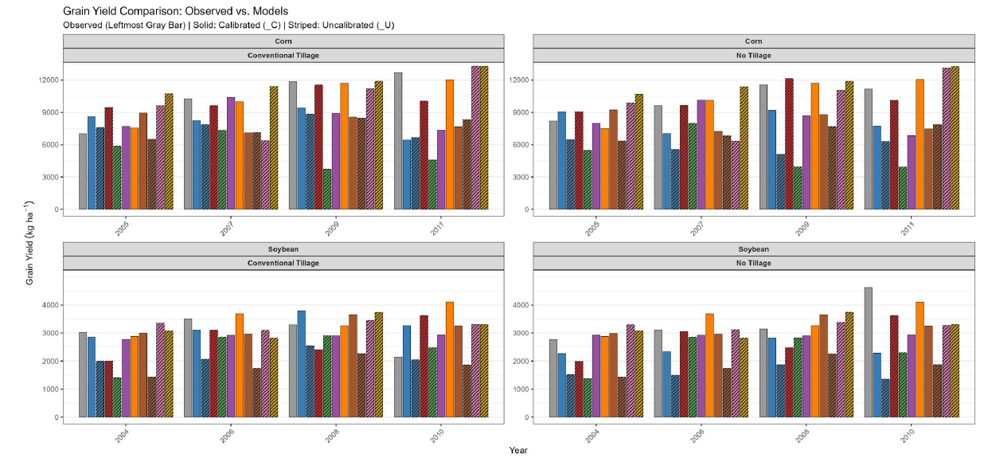
Phase 0 intercomparison result: Yield

Slide 20
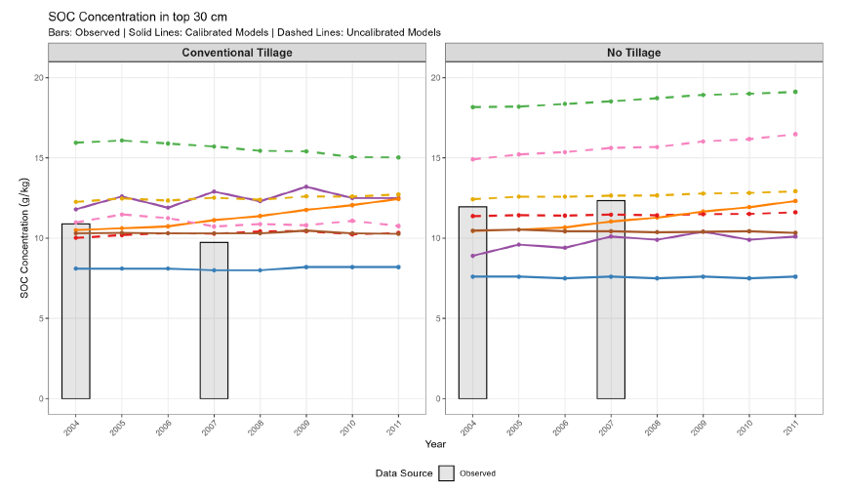
Phase 0 intercomparison result: SOC

Slide 21
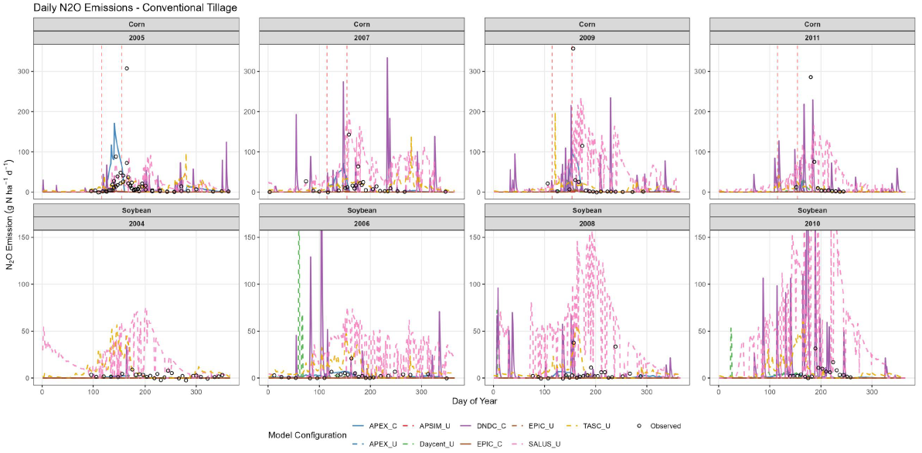
Phase 0 intercomparison result: N₂O

Slide 22
Interested in engaging in FP-MIP and related projects?
We are currently seeking site-level calibration and evaluation datasets. If you are a potential data provider, we would love to discuss possible collaboration opportunities.
We have related projects that can benefit from future collaborations. For example, there is an ongoing effort in collaboration with the National Soil Survey Center to model dynamic soil properties using NRCS and non-NRCS datasets. AgMIP is also leading the Earth Information For Food Project.
Contact us if you have suggestions about the best use of our planned modeling products and community-based platform for disseminating project results that are most relevant to farmers, ranchers, researchers, policymakers, and other stakeholders.

Slide 23
Acknowledgment
The work was funded by Public Law 117-169 - Section 21002(a)(2) through the U.S. Department of Agriculture’s Natural Resources Conservation Service. This project was supported through the U.S. Department of Agriculture’s Conservation Effects Assessment Project (CEAP), a multi-agency effort led by the Natural Resources Conservation Service (NRCS) to quantify the effects of voluntary conservation and strengthen data-driven management decisions across the nation’s private lands (Award number: NR253A750023C010).
Disclaimer
The findings and conclusions in this publication are those of the author(s) and should not be construed to represent any official USDA or U.S. Government determination or policy.
Acknowledgement

