Slide 1






RPA Modeling Efforts: Piecing Together the Bioeconomy
JESSE D. HENDERSON
USDA Forest Service
Research Economist and Project Leader
Forest Economics and Policy Unit

Slide 2
Historical Background: RPA
RPA: Resources Planning Act (1974)
Assessments every 10 years and, typically, updates 5 years later.
First RPA Assessment 1977 (approaching 50 years)

Slide 3
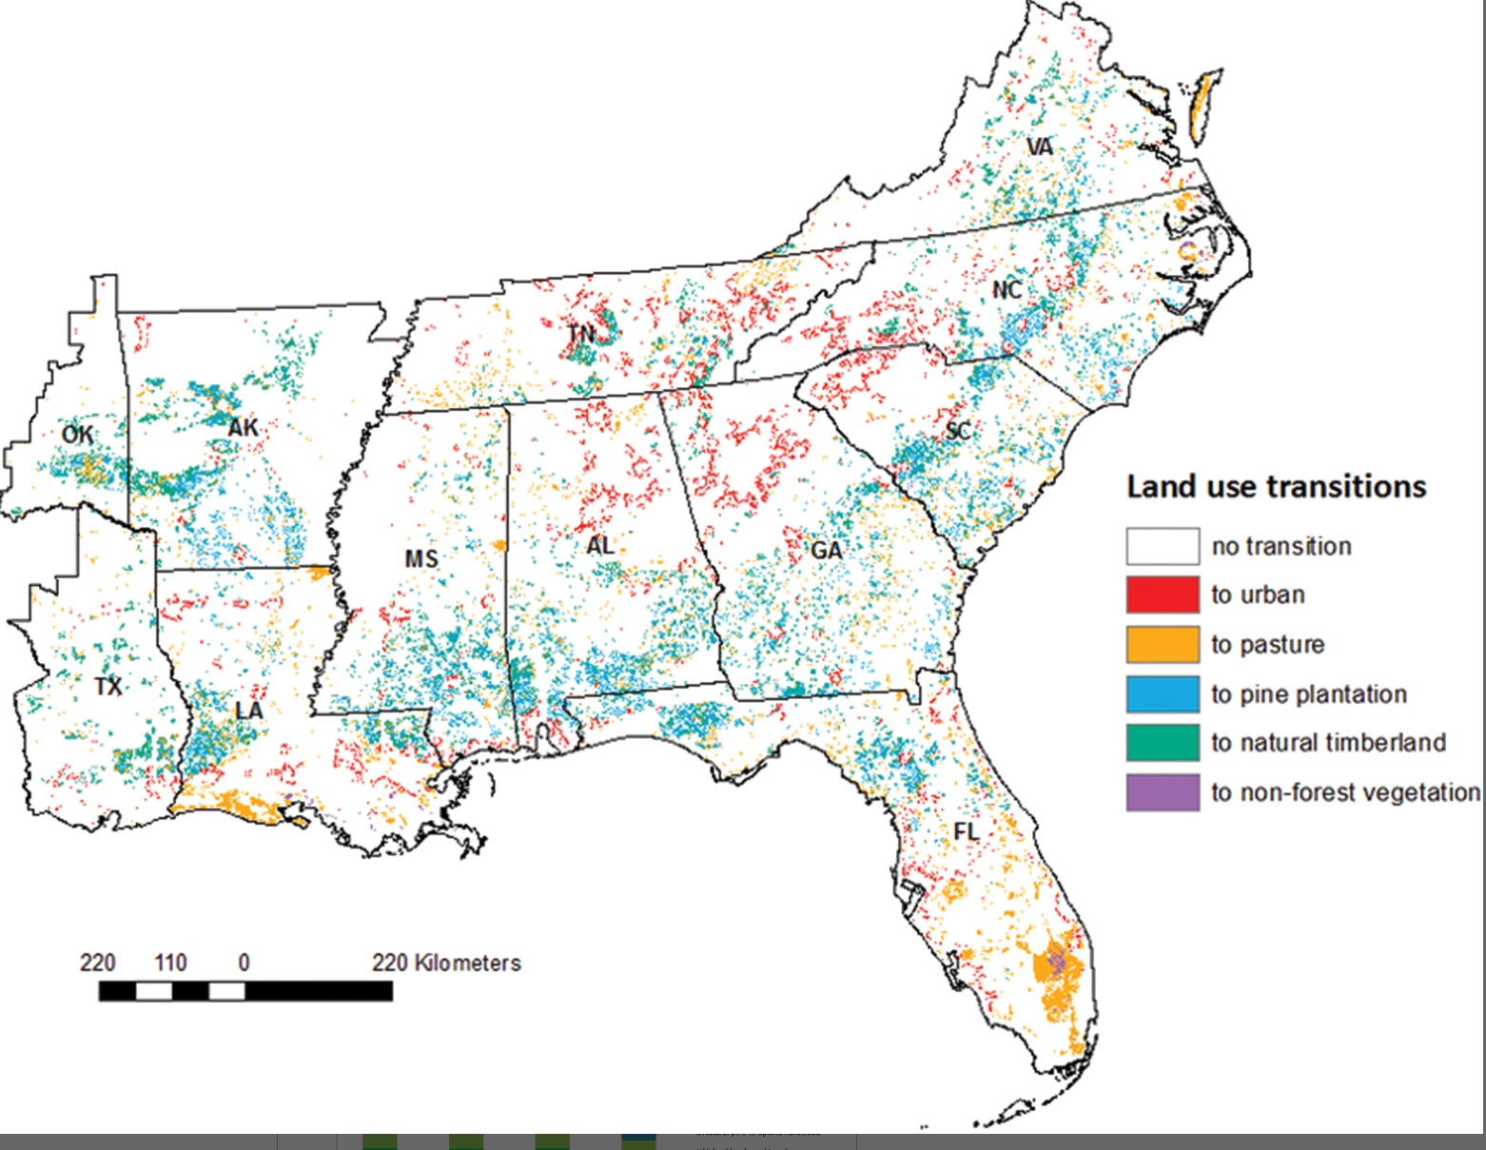
BIOENERGY AND LAND USE
QUESTION: How does a new forest product interact with existing markets and forest resources?
IMPORTANCE: Mills want to know if new products will change their input costs. New products offer alternative value streams to landowners. The carbon balance is important for climate change implications
Abt, R. C., Abt, K. L., Cubbage, F. W., Henderson, J. D. (2010). Effect of Policy-based Bioenergy Demand on Southern Timber Markets: A Case Study of North Carolina. Biomass and Bioenergy. https://doi.org/10.1016/j.biombioe.2010.05.007 (Refereed)
Galik, C. G., Abt, R. C., Henderson, J. D. (2010) The Near-Term Market Implications of Forest Biomass Co-firing in the Southeastern United States. Climate Change Policy Partnership (Duke University) White Paper.
Galik, C. G., Abt, R. C., Latta, G., Méley, A., Henderson, J. D. (2016). Meeting renewable energy and land use objectives through public-private biomass supply partnerships. Applied Energy. https://doi.org/10.1016/j.apenergy.2016.03.047. (Refereed)
Duden, A. S., Verweij, P. A., Junginger, H. M., Abt, R. C., Henderson, J. D., Dale, V. H., . . . van der Hilst, F. (2017). Modeling the impacts of wood pellet demand on forest dynamics in southeastern United States. Biofuels, Bioproducts and Biorefining. https://doi.org/10.1002/bbb.1803 (Refereed)
It’s a new product, so how do we model it?
  Policy-based demand
New modules for the Sub-regional Timber Supply model (residues); Model refinement to capture sawmill waste
Bioenergy/pellets vs. Coal
On the ‘plus’ side of the carbon ledger: higher prices >> more planting >> more carbon.

Slide 4
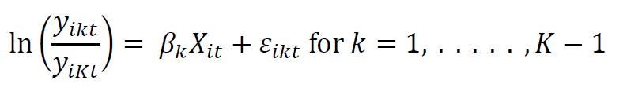
BIOENERGY AND LAND USE
PROBLEM: If bioenergy benefits rely on land use change, we should make sure our land use change model is accurate.
IMPORTANCE: Beyond the considerations of biomass or pellets alone, this model helps us understand price and land us change outcomes due to mill closures or openings
Land share (y), survey unit (i), land use (k), time (t), parameters (Beta), explanatory
variables (X)
Selected parameter estimates for the estimated model (n = 492 for each equation).
Equation | Variable | Coefficient | Std. Error | t-value | Pr(>|t|)
agriculture | ln(rent) | -0.093 | 0.073 | -1.276 | 0.203
 | ln(population) | -0.141 | 0.031 | -4.476 | <2e-16
 | ln(per capita income) | -1.044 | 0.188 | -5.563 | <2e-16
pine plantation | ln(rent) | 0.560 | 0.130 | 4.294 | <2e-16
 | ln(population) | -0.668 | 0.056 | -11.928 | <2e-16
 | ln(per capita income) | -0.204 | 0.334 | -0.612 | 0.541
natural pine | ln(rent) | -0.098 | 0.086 | -1.143 | 0.254
 | ln(population) | -0.294 | 0.037 | -7.985 | <2e-16
 | ln(per capita income) | -0.882 | 0.220 | -4.007 | <2e-16
mixed oak pine | ln(rent) | -0.041 | 0.069 | -0.599 | 0.55
 | ln(population) | -0.255 | 0.030 | -8.577 | <2e-16
 | ln(per capita income) | -1.025 | 0.177 | -5.785 | <2e-16
upland hardwood | ln(rent) | -0.019 | 0.061 | -0.305 | 0.76
 | ln(population) | -0.279 | 0.026 | -10.703 | <2e-16
 | ln(per capita income) | -1.058 | 0.155 | -6.803 | <2e-16
Henderson, J. D., Abt, R. C., Abt, K. L (2024). Forest carbon under increasing product demand and land use change in the US Southeast. Forest Policy and Economics, Volume, 167. https://doi.org/10.1016/j.forpol.2024.103296. (Refereed )

Slide 5
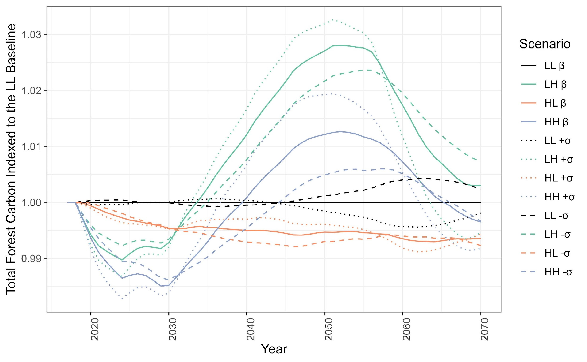
BIOENERGY AND LAND USE
CARBON METRICS

Slide 6
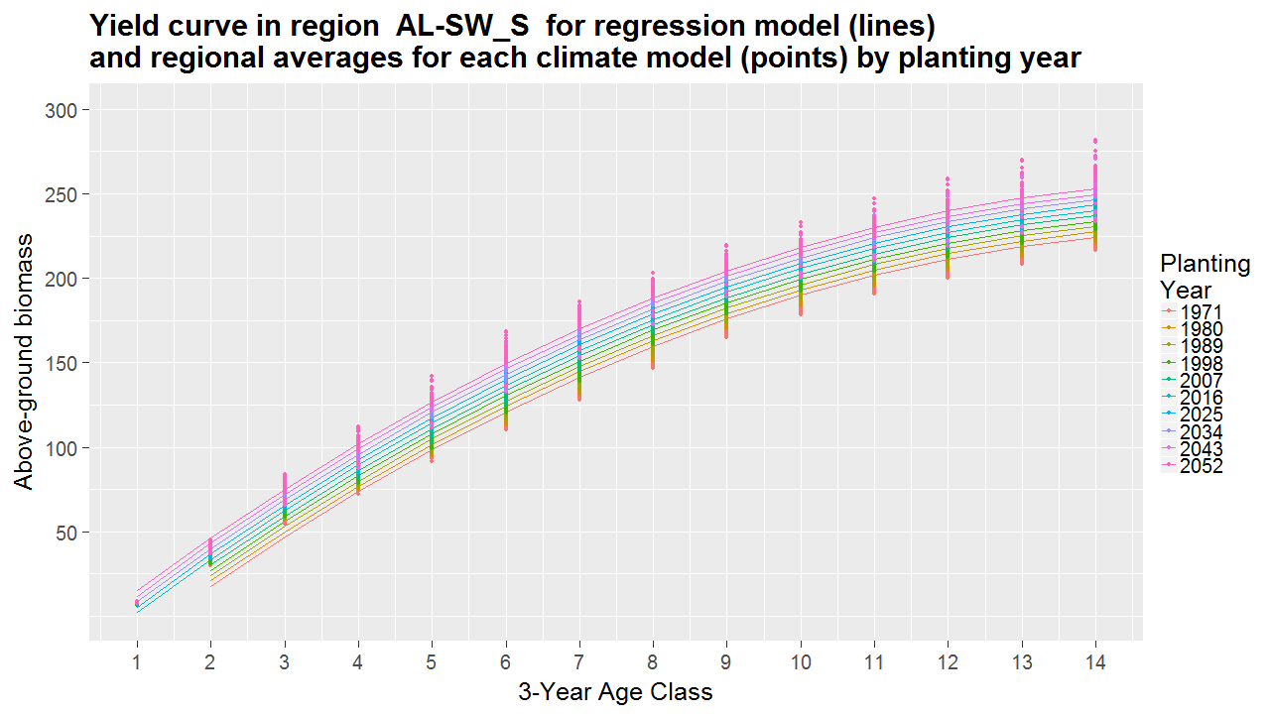

FOREST CARBON AND CARBON MARKETS
Regression summaries of 3PG model output
Thomas, R. Q., Jersild, A. L., Brooks, E. B., Thomas, V. A., & Wynne, R. H. (2018). A mid-century ecological forecast with partitioned uncertainty predicts increases in loblolly pine forest productivity. Ecological Applications, 28(6), 1503–1519. https://doi.org/10.1002/eap.1761
Implementation in SRTS:
Henderson, J. D., Parajuli, R., & Abt, R. C. (2020). Biological and market responses of pine forests in the US Southeast to carbon fertilization. Ecological Economics, 169(March). https://doi.org/10.1016/j.ecolecon.2019.106491
Mei, B., Wear, D. N., & Henderson, J. D. (2019). Timberland investment under both financial and biophysical risk. Land Economics, 95(2), 279-291. https://doi.org/10.3368/le.95.2.279 (Refereed)
Land Economics paper:

Slide 7
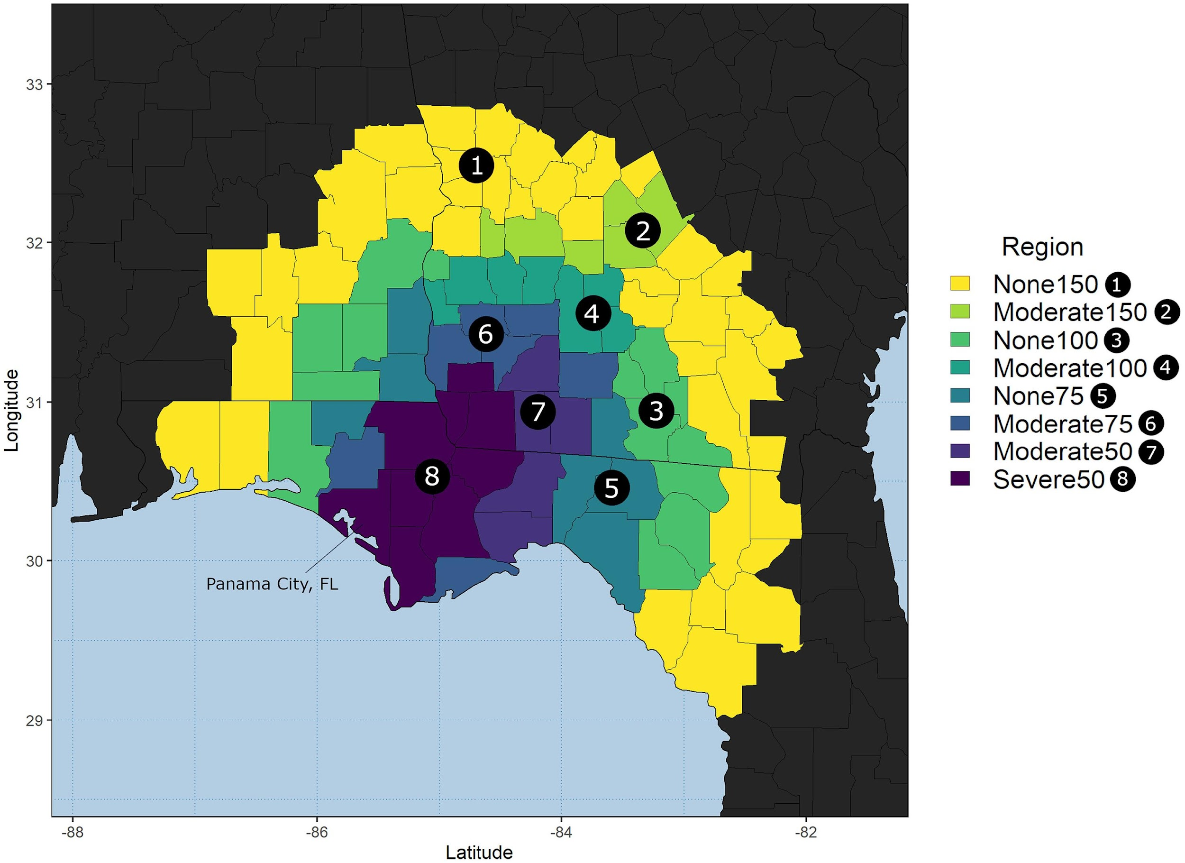
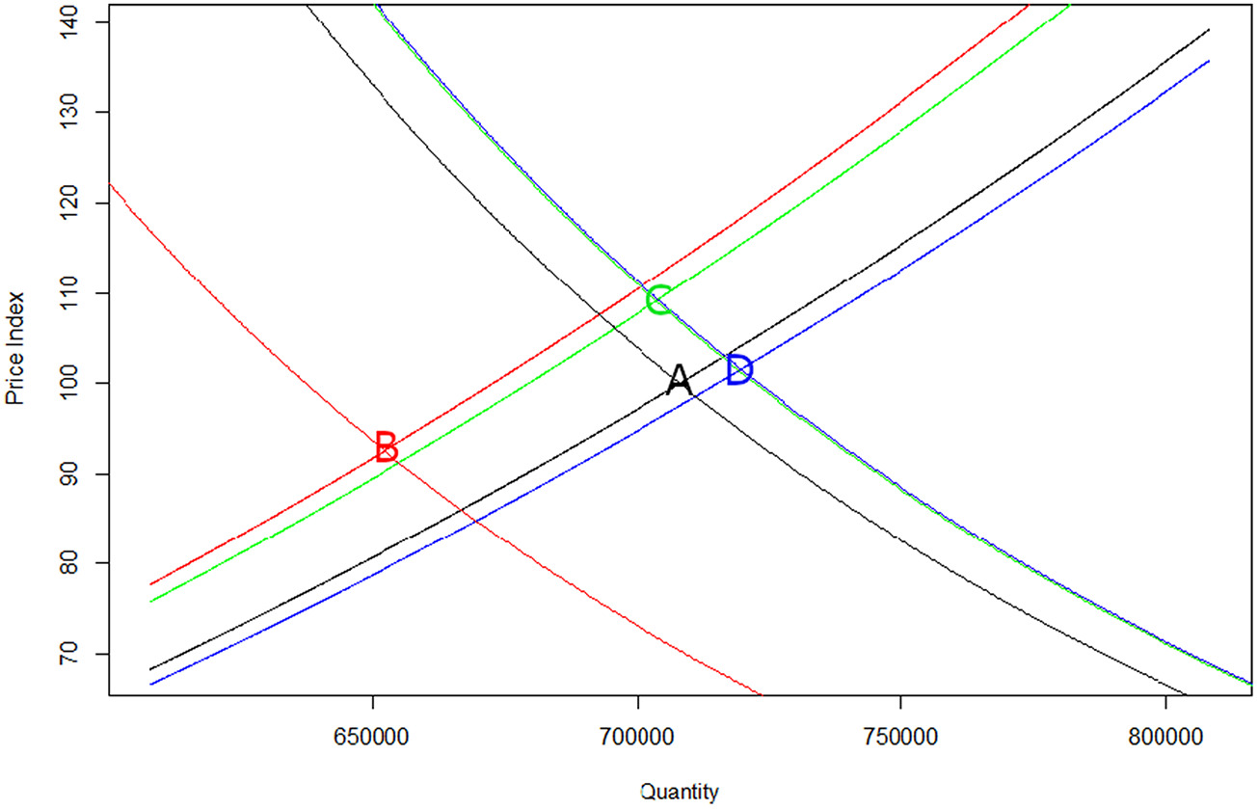
HURRICANES AND TIMBER MARKETS
https://doi.org/10.1016/j.forpol.2022.102735

Slide 8
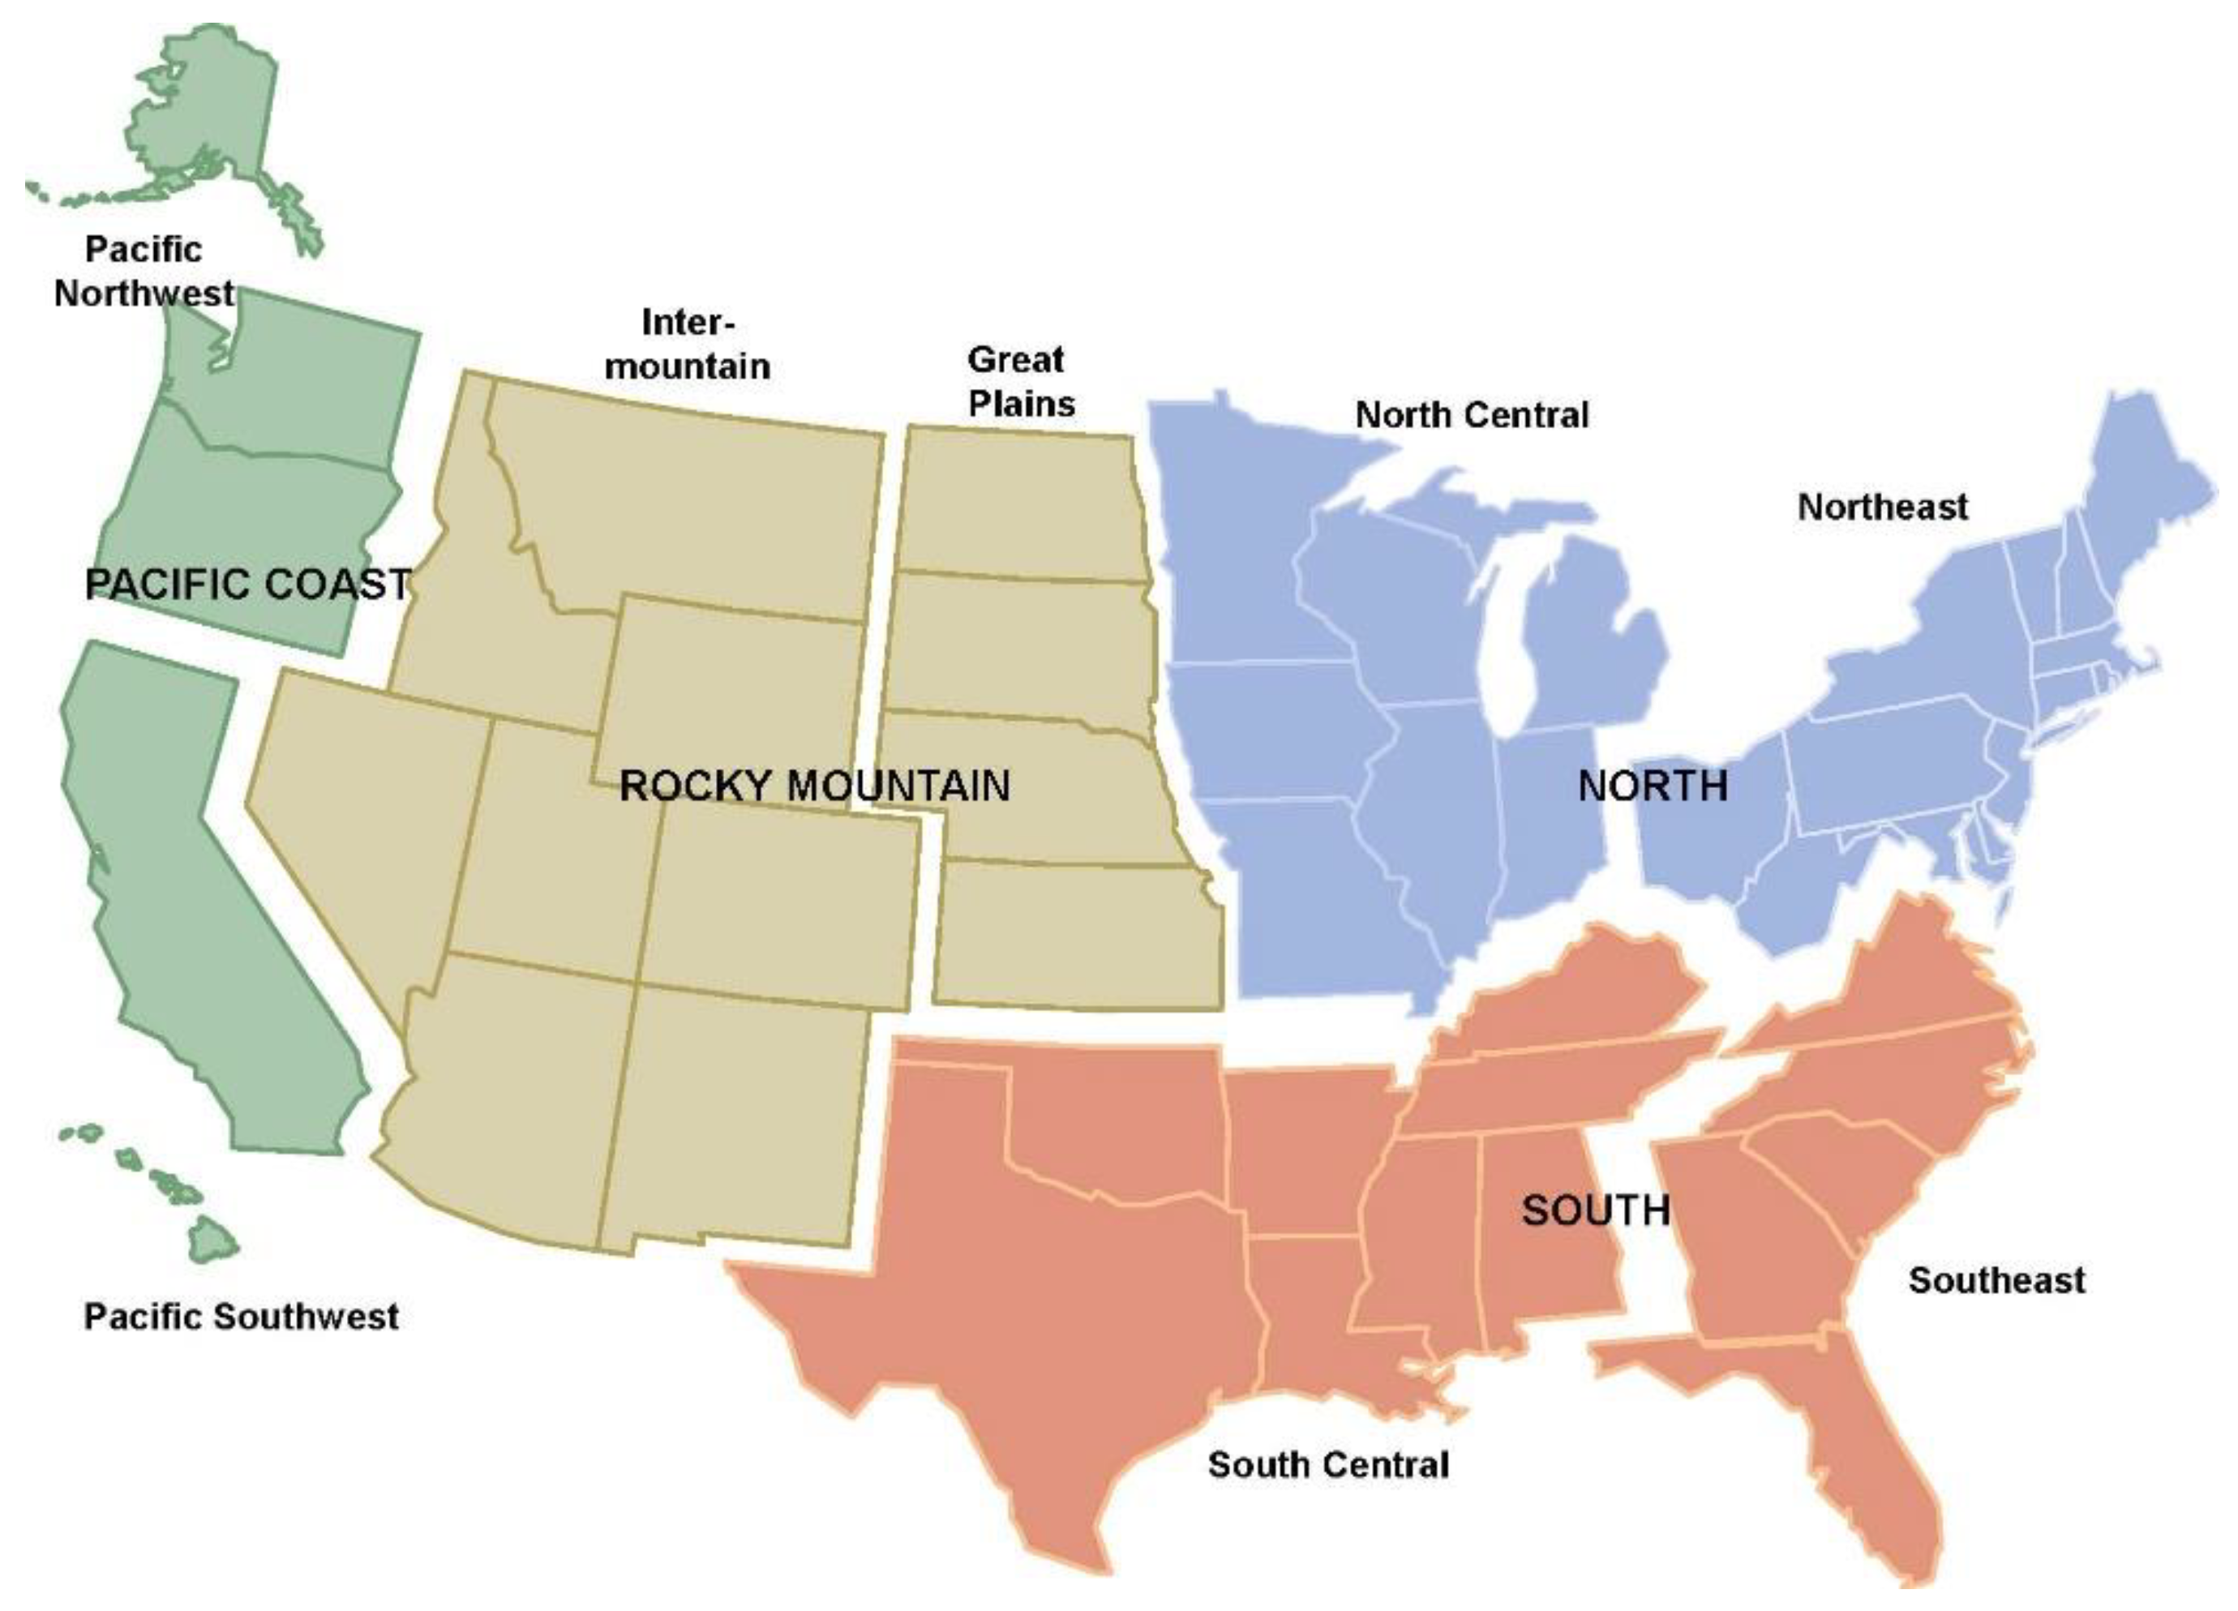
FOROM disaggregation in the US. All other countries in FAO data are represented as well.
Countries can be flexibly grouped and the model recalibrated.

Slide 9
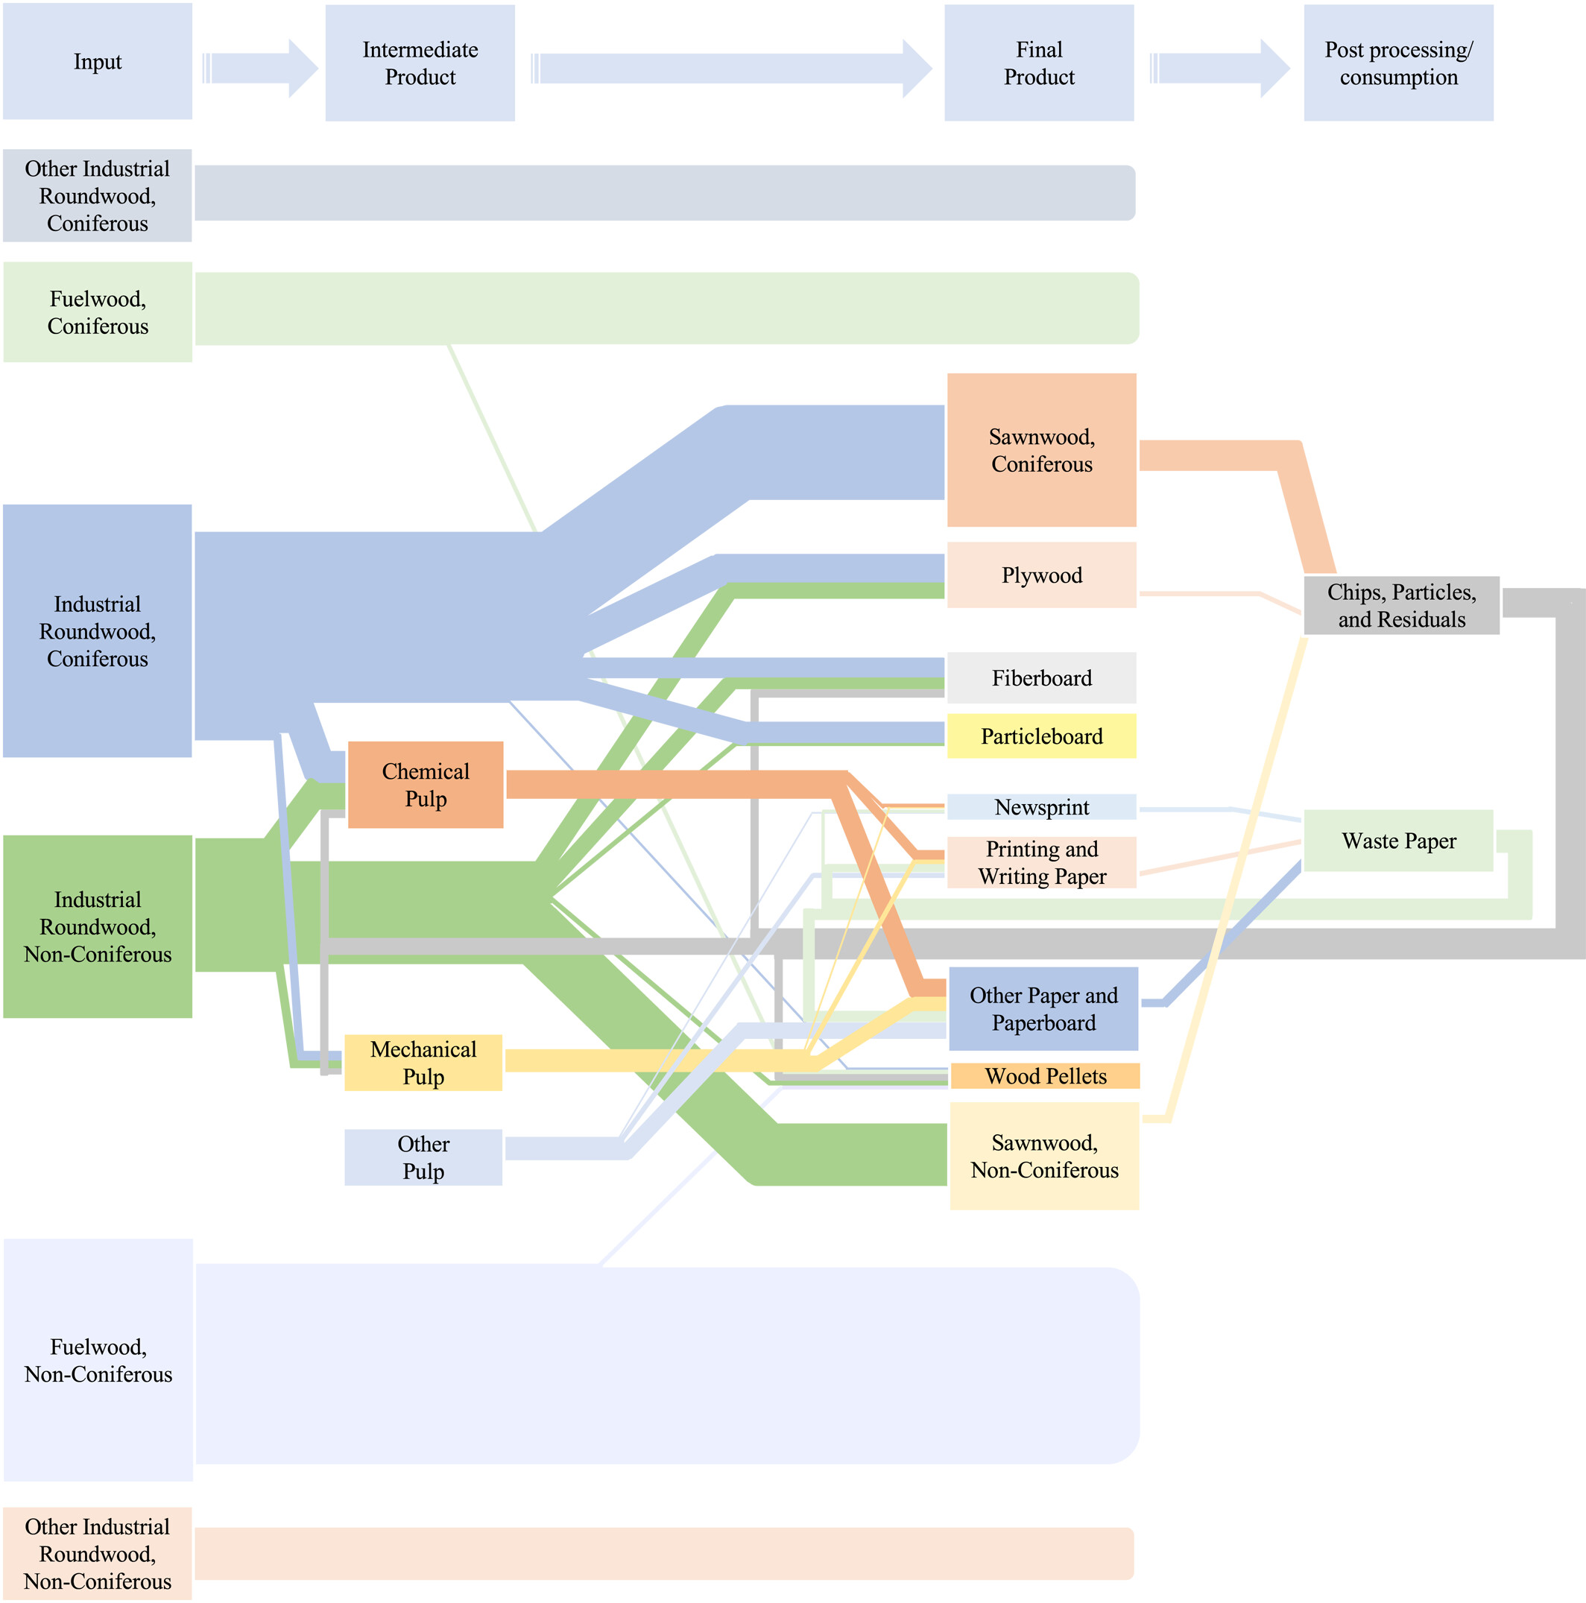
PRODUCT FLOWS
For RPA work, integrates with the Forest Dynamics Model for rich detail on growth/removals dynamics (based on plot imputation of FIA data)

Slide 10
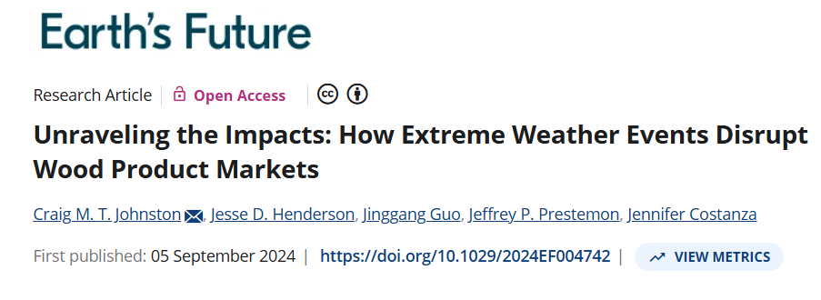
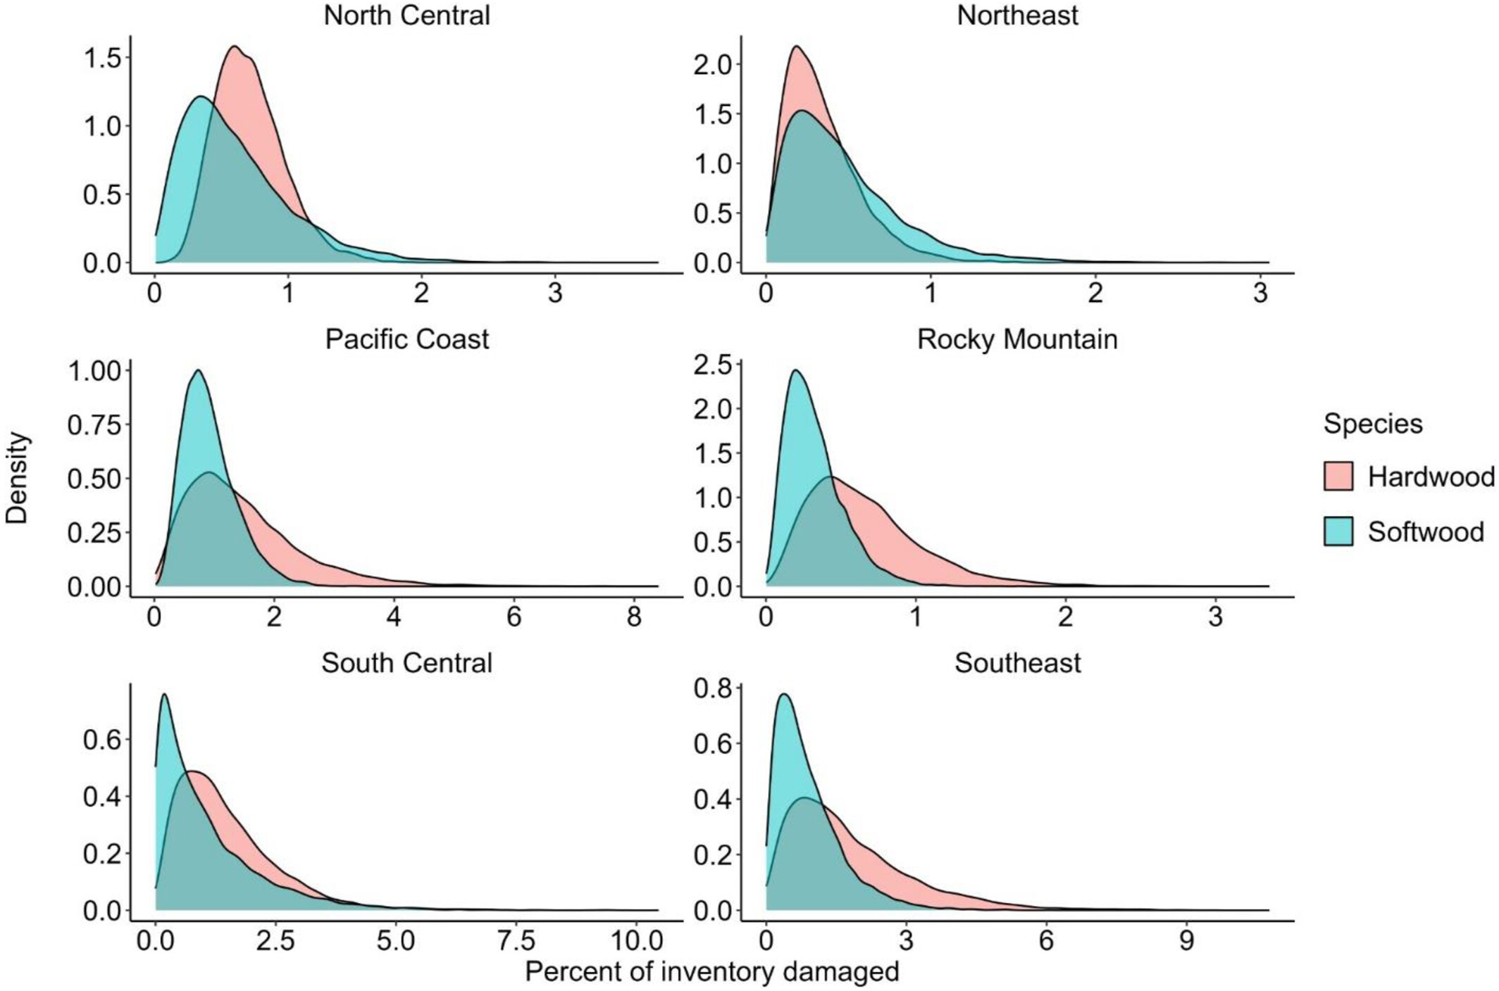
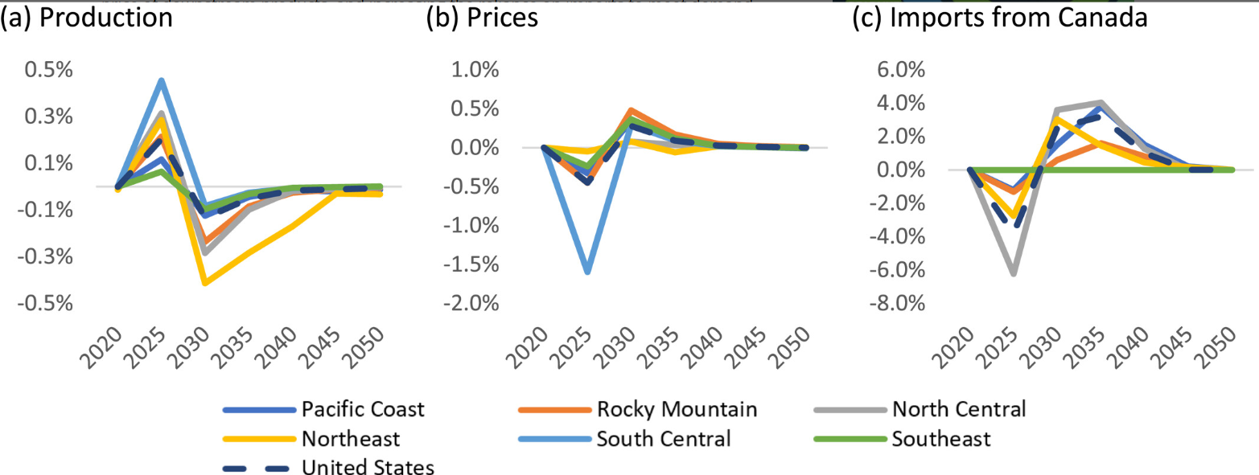
FOROM: HURRICANES AND TIMBER MARKETS

Slide 11
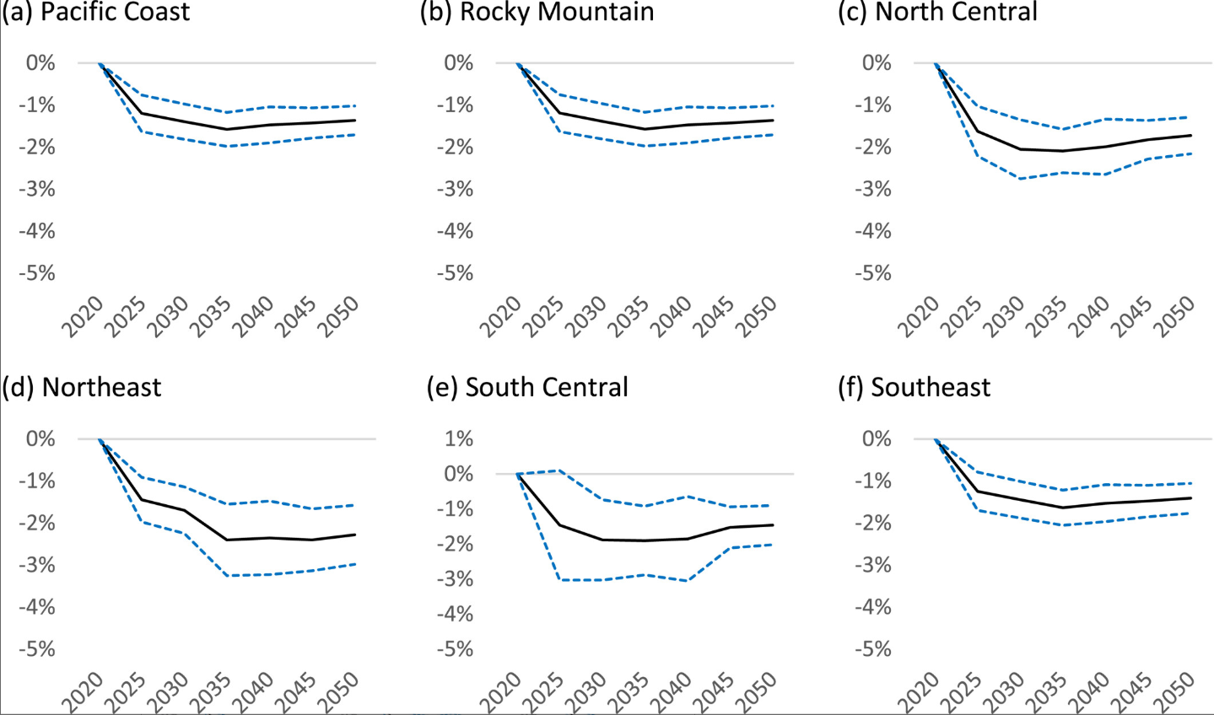
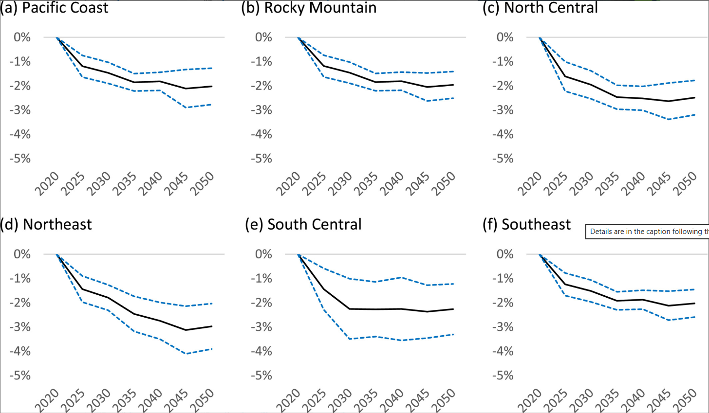
With repeated wind events, prices are held down, with no elevated prices following disturbance in expectation.
Shifting the distribution of damage reduces prices further.
Estimated change in roundwood prices by US region under current damage rates, percent, 2025–2050. Note: dashed lines represent 95% confidence interval based on Monte Carlo simulations.
Estimated change in roundwood prices by US region under increasing damage rates, percent, 2025–2050. Note: dashed lines represent 95% confidence interval based on Monte Carlo simulations.

Slide 12
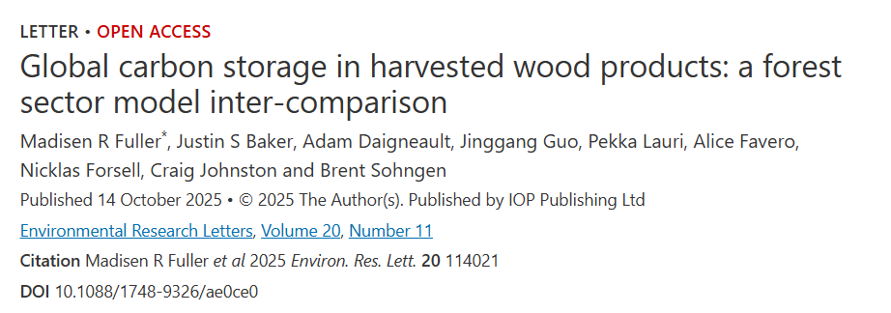
Additional Developments
Module now embedded in FOROM
Lumber demand elasticities w.r.t. price, GDP, and housing starts
Johnston, C., Guo, J., Prestemon, J. (2026). Revisiting U.S. Softwood Lumber Demand Projections: The Central Role of Residential Construction in Forest Sector Outlooks.
Accepted in Forest Policy and Economics

Slide 13
FOROM: NFS Harvests,
Tariffs, & Duties
GTR evaluating impacts of NFS harvest increases, duties on Canadian softwood lumber and tariffs on all countries (except Canada, Mexico).
Softwood Lumber

Slide 14
Outputs coming soon.
Submitting: Guo, J. et al. Paper that integrates the MC2* model in FOROM.
Henderson, J. D. et al. 2026. General Technical Report on NFS harvests, tariffs, duty … (under review)
*process-based, gridded vegetation model developed by the USDA Forest Service Pacific Northwest Research Station (John Kim)

Slide 15
Other Pieces and Models
Adam Daigneault: Harvest probability models > Forest Dynamics Model > RPA/FOROM
Jinggang Guo, Jeff Prestemon: Economics of Biomass Removals (EBR) model.
    Guo, Prestemon, Henderson. (2026) Wood Pellet Market Restructuring under the European Union Deforestation Regulation: A Dynamic Spatial Equilibrium Analysis. Accepted at Biomass and Bioenergy.
Bruno Kanieski da Silva: Agent-Based Forest Sector models:
    Kanieski, Henderson, et al. (2026) Evaluating Carbon Additionality under Short-Term Harvest Deferrals in U.S. Southern Plantation Forests . Accepted in Forest Policy and Economics.
Greg Latta: LURA and FASOM, “western SRTS”
Justin Baker, Richard Manner: “western SRTS”

Slide 16
THANKS

