Slide 1
Regional simulations of market-mediated forest responses to scaling biomass-based decarbonization
Justin S. Baker
Associate Professor, Forestry and Environmental Resources
Director, Southern Forest Resource Assessment Consortium
Director, Forest Carbon Solutions Initiative

Slide 2
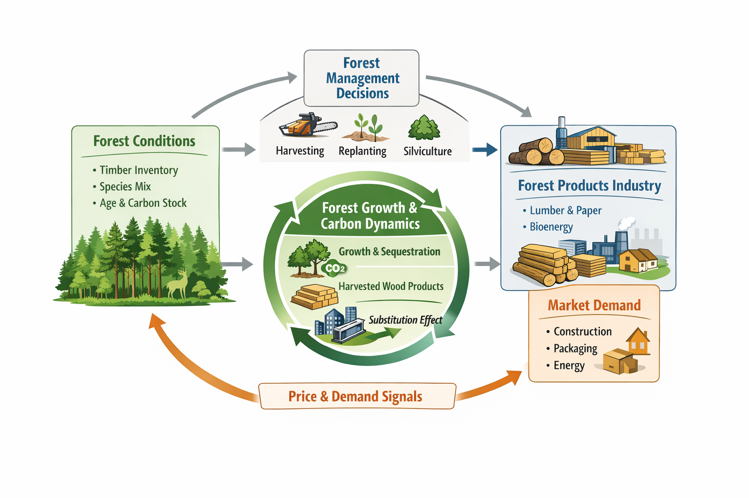
Background Context
We’ve talked about markets and how they can influence forest management and land use
Modeling market dynamics is critical for:
  Establishing additionality criteria
  Quantifying impacts of shifting demand or policy interventions

Slide 3
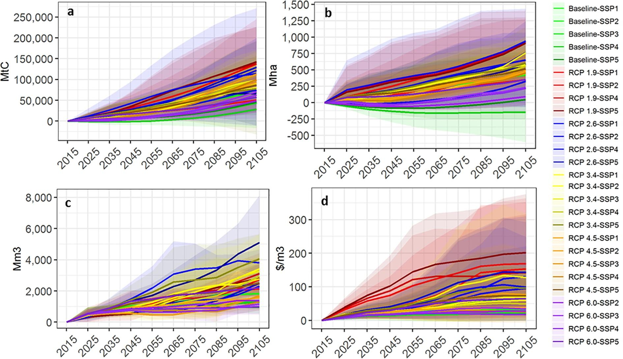
Background Context
Scale Considerations
  Global-scale modeling efforts great for big-picture policy, market, and environmental change scenarios
Figure from Global For-MIP Manuscript (Daigneault et al., 2022)

Slide 4
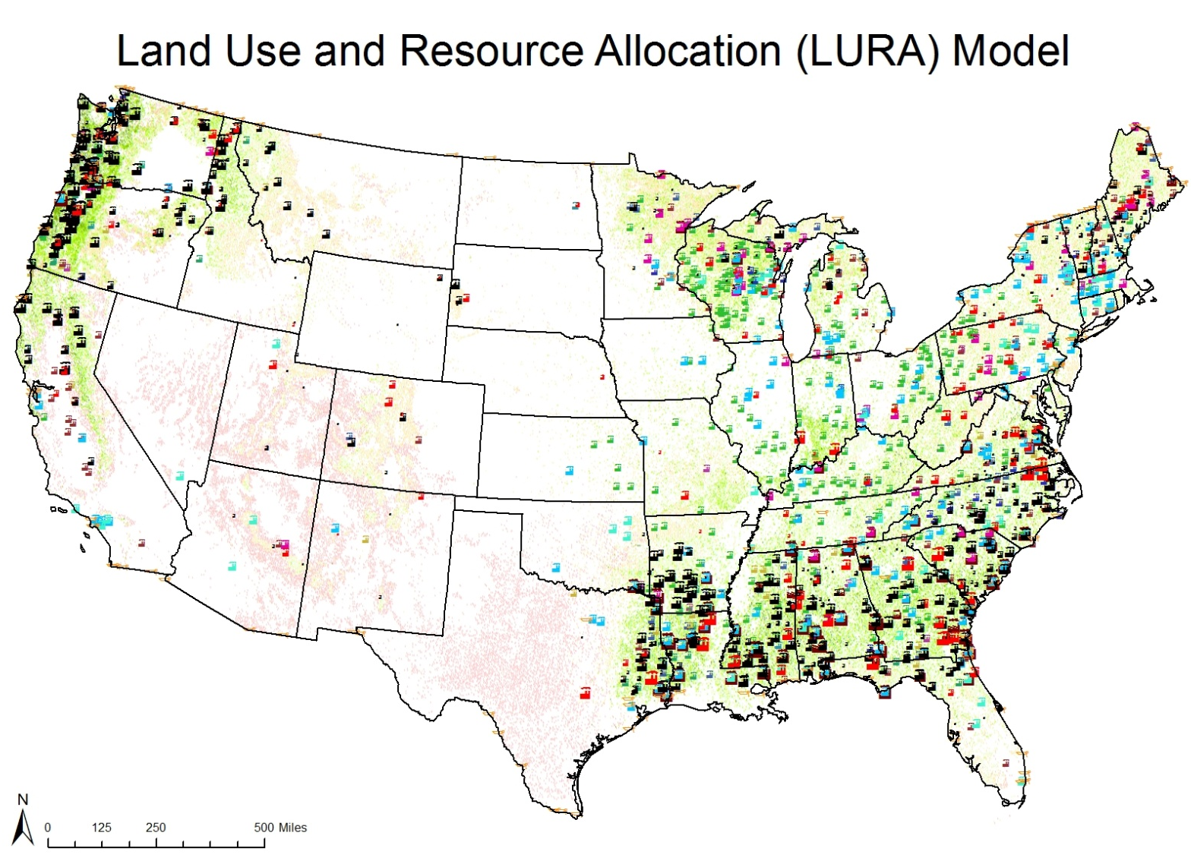
Background Context
Scale Considerations
  National-scale tools are useful for similar contexts
  Some (e.g., LURA) provide key spatial information on how the resource base (supply) and mills (demand) are connected

Slide 5
Background Context
Scale Considerations
  Regional models like the SubRegional Timber Supply Model (SRTS) offer a mix of nuance/spatial detail and ability to perform long-term market projections
  Ideal for subnational (or state-level) analysis

Slide 6
Background Context
US South is a critical global wood production source
Concerning decline in pulp mill capacity is putting downward pressure on markets generally
Some portions of the region are seeing mill capacity investment
  (e.g., bioenergy in the Gulf)

Slide 7
Methods
Multi-model assessment approach
  LURA provides national-scale look at spatial interactions
  SubRegional Timber Supply Model (SRTS) for longer-term outlooks within affected mill sheds
  LCA to quantify net emissions impacts

Slide 8
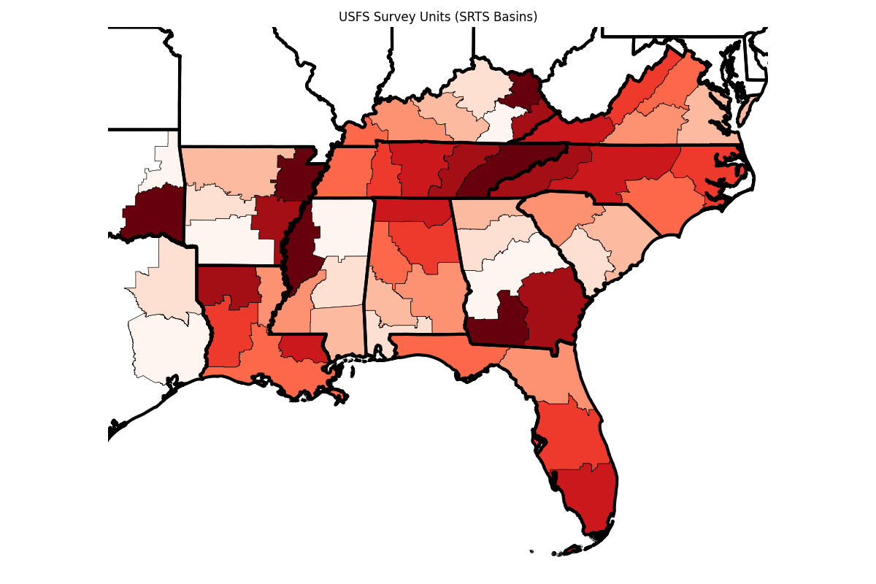
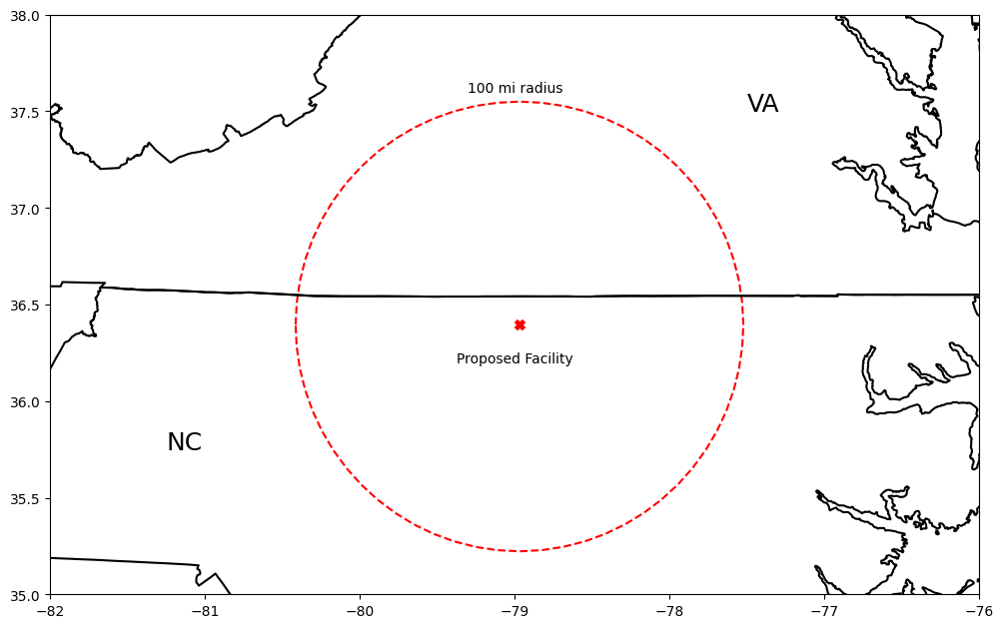
SRTS – A flexible regional partial equilibrium forest sector model

Slide 9
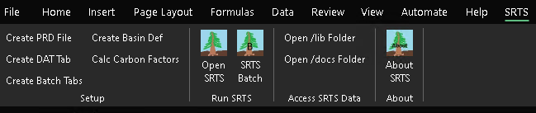
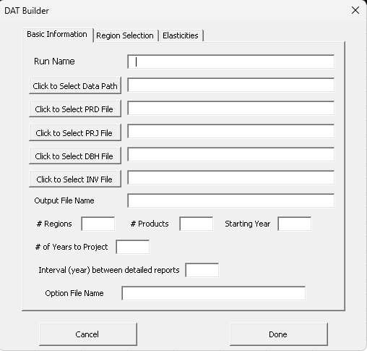
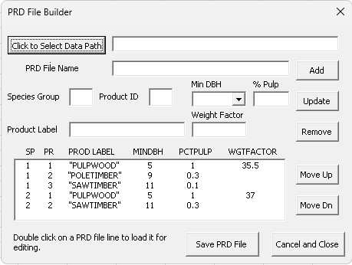
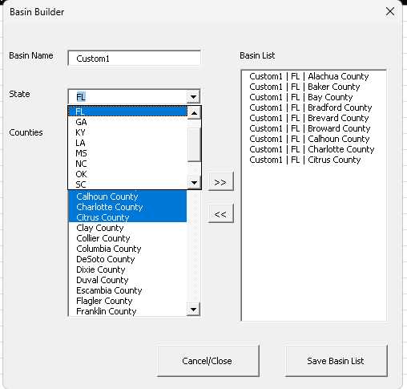
SRTS
2024 saw the transformation of SRTS into an Excel Add-in.
Makes the power of the SRTS economic model more accessible as it is now available on a widely available platform
Easy of use was a focus of the development effort, leading to the inclusion of several workflow wizards that aid in model setup.

Slide 10
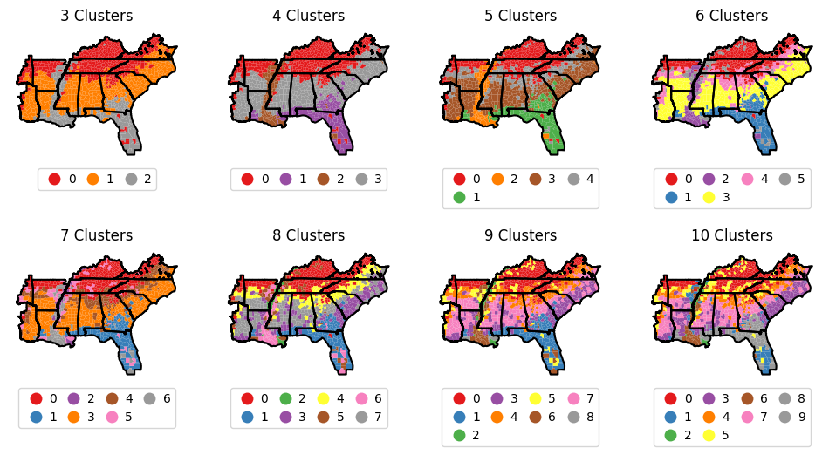
Carbon Calculations in SRTS
Leveraging the USFS EVALIDator API, k-means clustering, and Python we re-estimated carbon conversion factors for SRTS forest types age classes
Carbon Pools:
  All Live
  Standing Dead
  Total Understory
  Fine Woody Material
  Coarse Woody Material

Slide 11
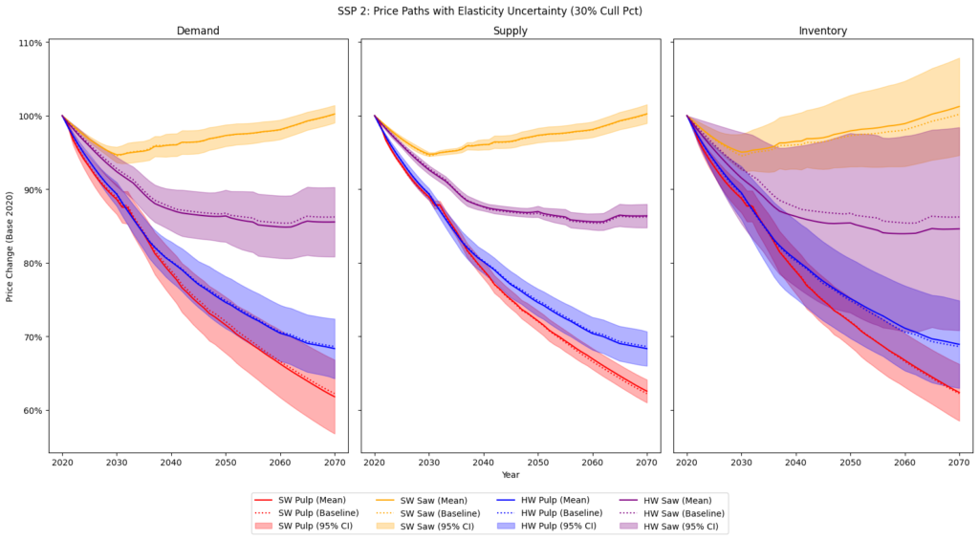
SRTS – A flexible regional partial equilibrium forest sector model
Convenient tool for building market and resource projections, incorporating uncertainty analysis

Slide 12
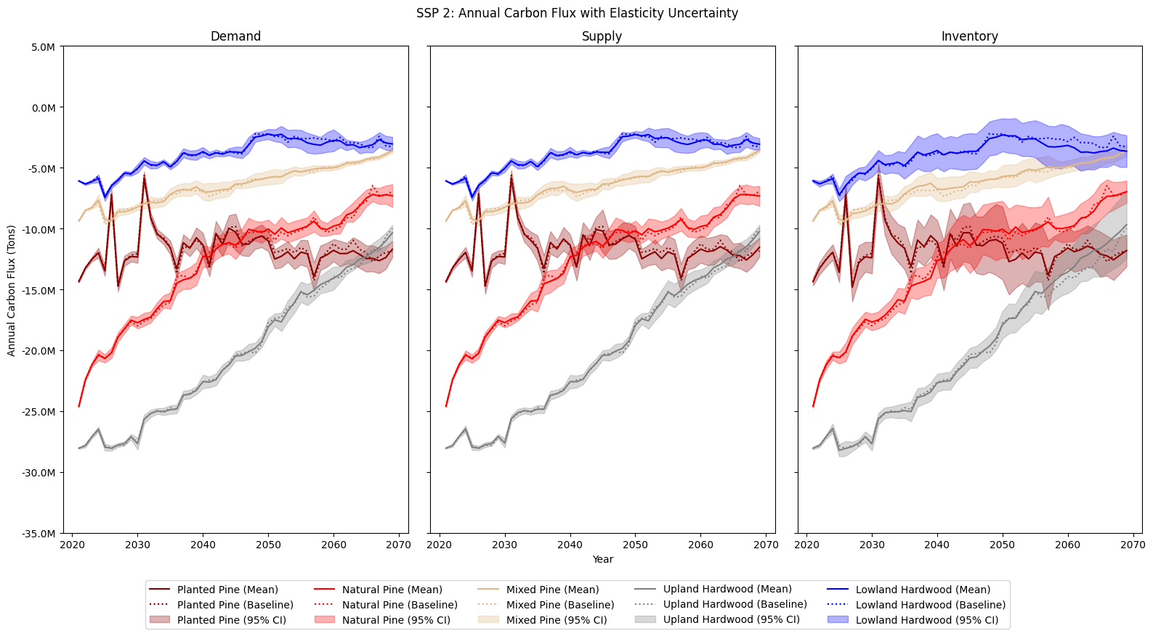
SRTS – A flexible regional partial equilibrium forest sector model
Regional C flux projections by forest type

Slide 13
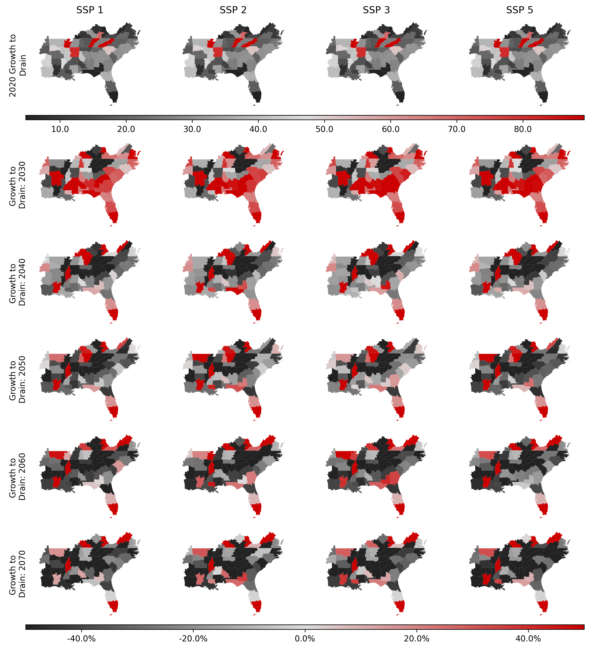
Dynamic growth-to-drain over time

Slide 14
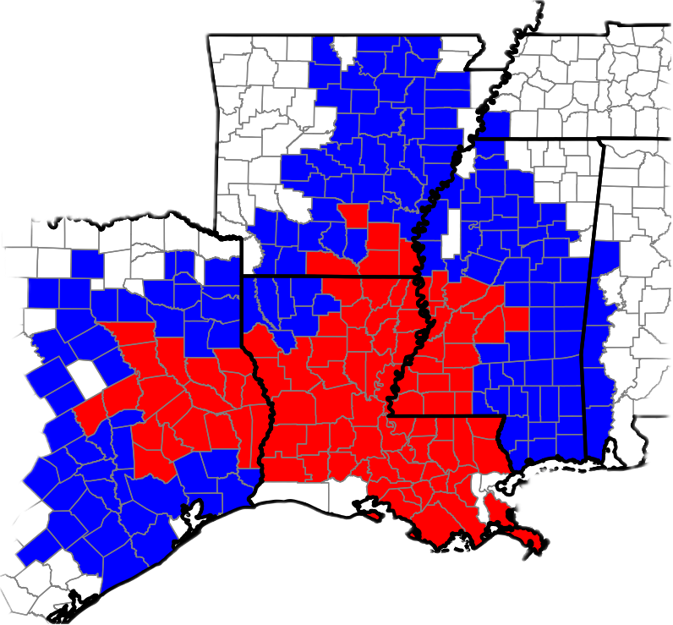
LURA to SRTS Linkage
Use LURA to establish spatial extent of the market
Define SRTS market regions
  In red – primary timber shed for new bioenergy mills
  In blue – full timber shed that includes competitive mills

Slide 15
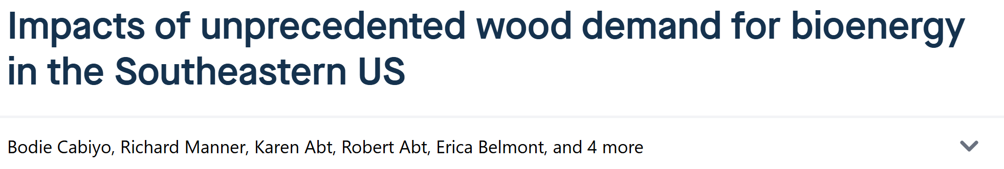
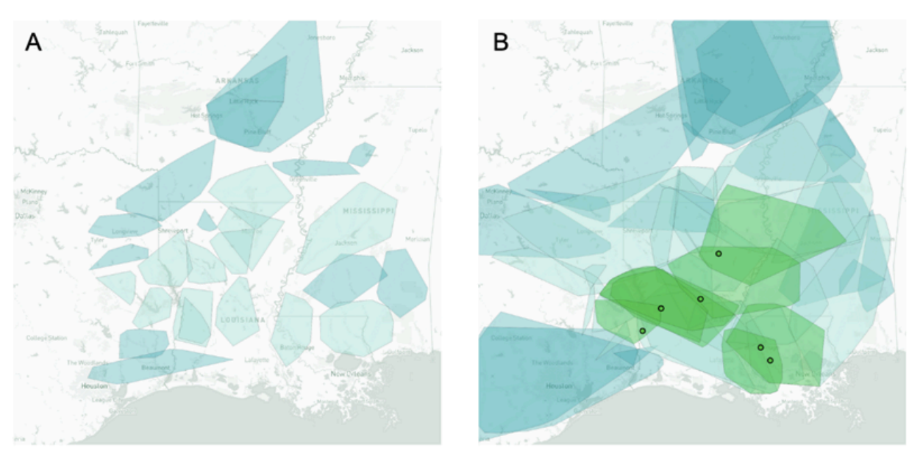
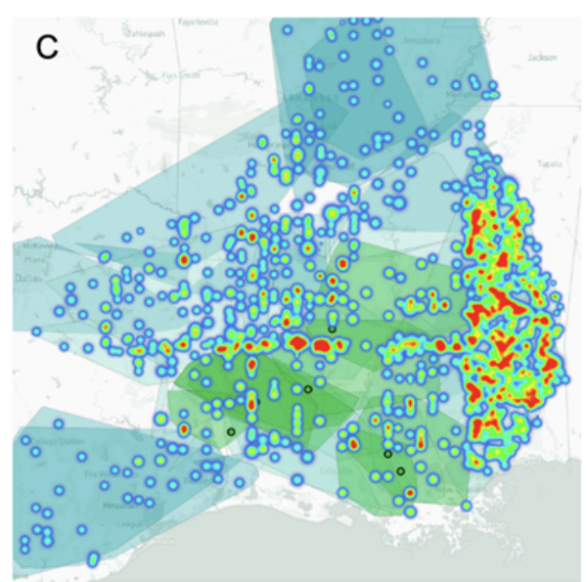
LURA to SRTS Linkage
Substantial investment in new bioenergy facilities across the U.S. Gulf Coast region
  Louisiana in particular
We developed a multi-model assessment that links LURA, SRTS, and LCA

Slide 16
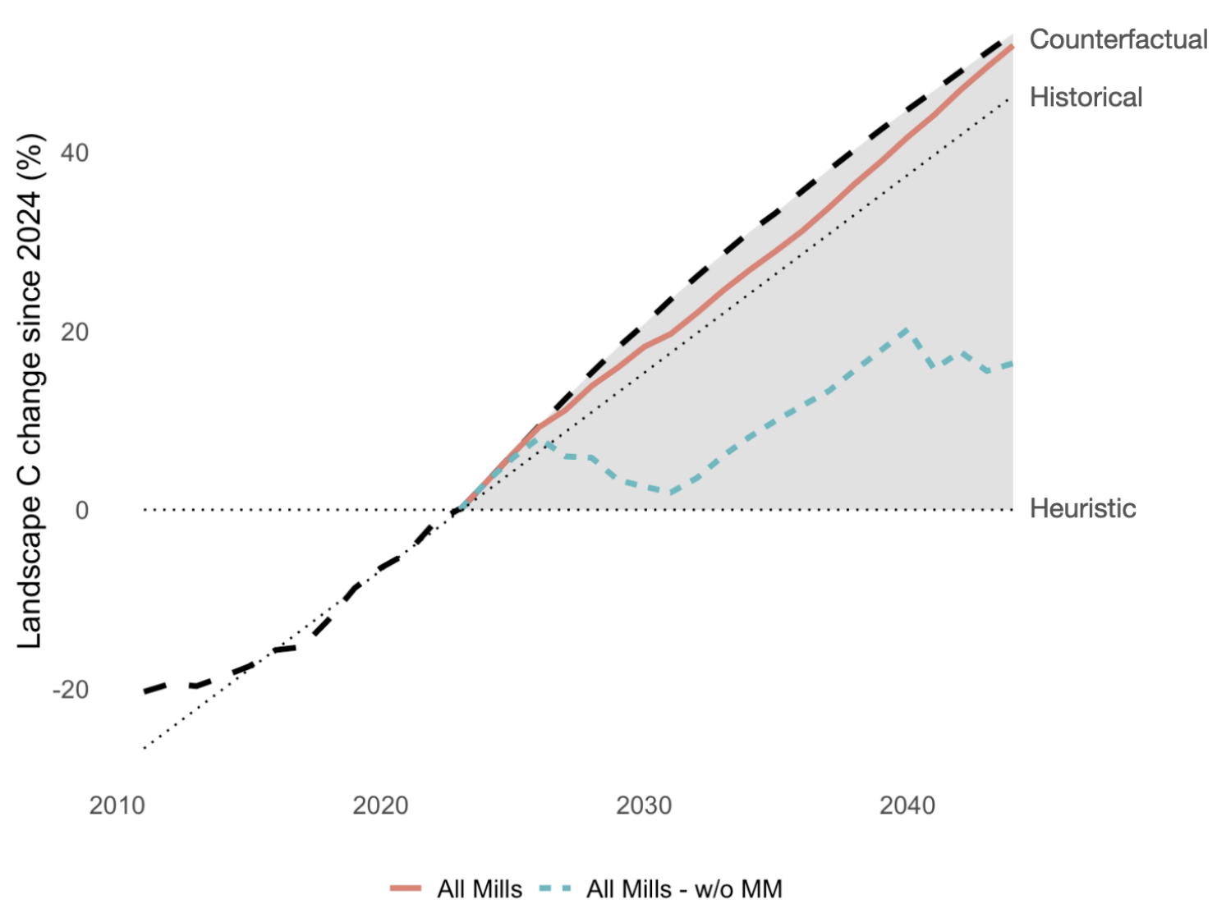
Carbon Projections for the Subregion

Slide 17
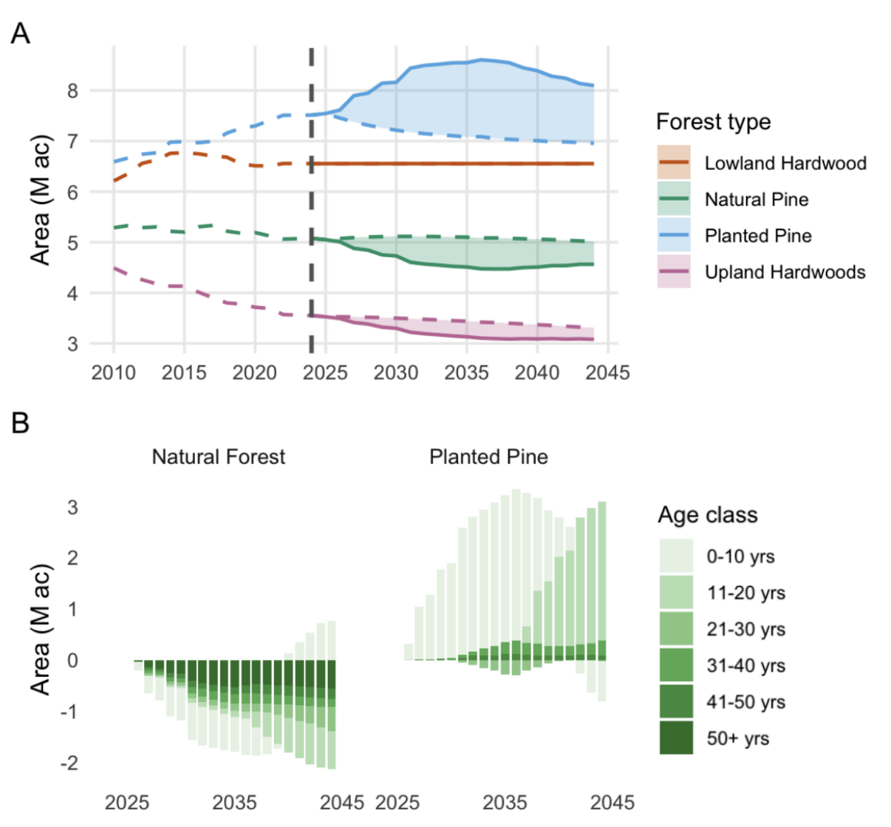
What’s driving landscape C changes?

Slide 18
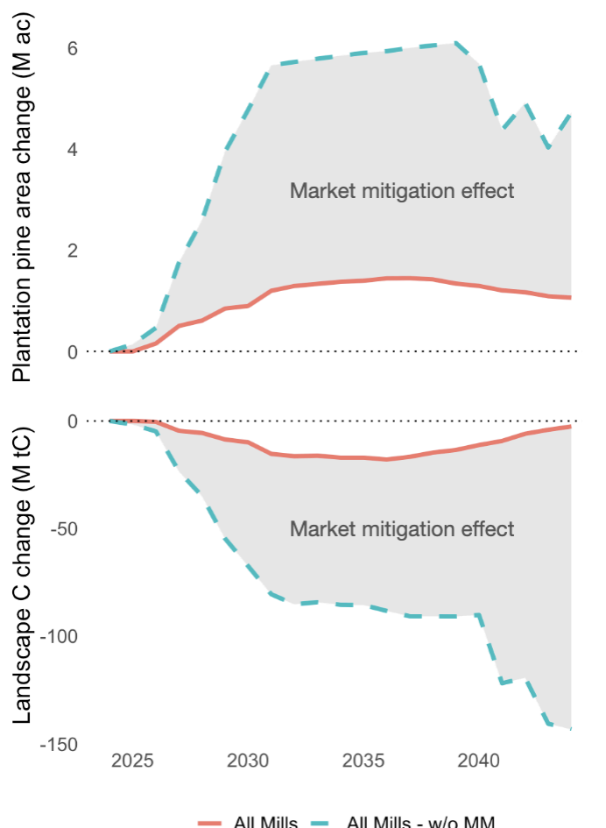
Landscape C Change Results
Markets matter –
  When we analyze scenarios w/o market feedback, C and LU implications are substantially different
    Market mitigation effect

Slide 19
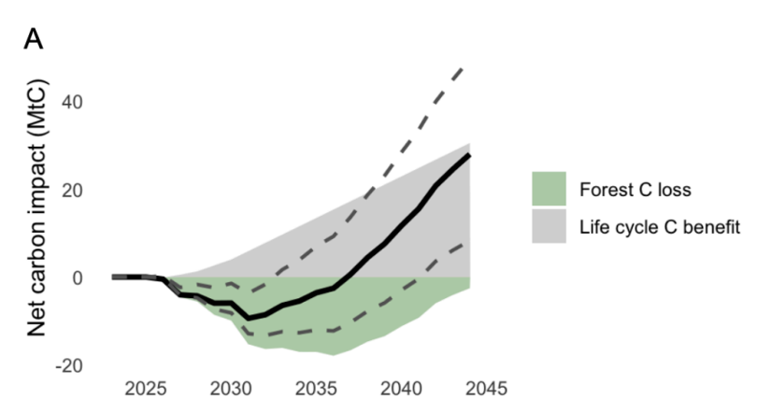
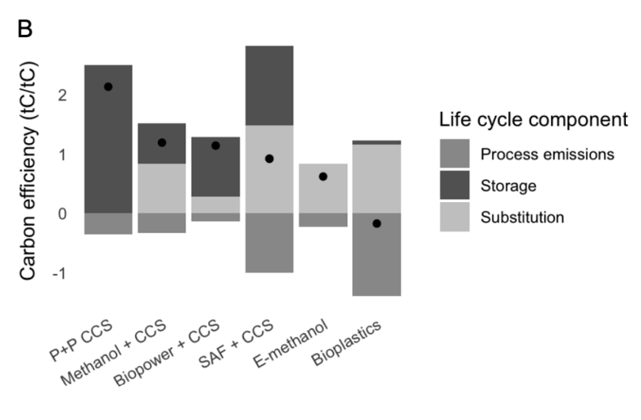
Landscape Carbon Changes + Life Cycle Benefits

Slide 20
Summary
Bioenergy can improve carbon outcomes of wood allocation at global and regional scales
Markets matter and we should use models that reflect market/resource dependencies!
Context matters
  More nuanced timber shed-scale analysis can provide novel insight to regional stakeholders
  New opportunities to link economic modeling and LCA

Slide 21
Questions?
Justin S. Baker – justinbaker@ncsu.edu
  Associate Professor, Forestry and Environmental Resources
  Director, Southern Forest Resource Assessment Consortium (SOFAC)
  Director, Forest Carbon Solutions Initiative (FCSI)
  NC State University

